Slide 1
Doc team diagrams
Your starting point for great diagram designs
go/doc-diagrams
Leif Brown Last updated Dec 2023

Slide 2
Diagram-making flow
Create a slide.
2. Save the slide
Copy this deck and save it as your own.
Add a new slide or select an existing slide in your deck and either overwrite it or duplicate it.
When you’re happy with your diagram:
At the top of the slide, add a descriptive title and the anticipated path/to/filename.png in the docs repo
Copy and paste the slide to the bottom of this deck
Download the slide as a .png (File > Download > PNG image)
Crop out extraneous space or footers using Snagit or your favorite tool
Add the file to an appropriate folder in /source/_static/images
Tip:
Look for existing diagrams that get close to telling the story you want and copy from them shamelessly.
If you copy a slide from another deck, use “Match styles in this presentation” when you paste it.

Slide 3
Diagramming best practices

Slide 4
Font
Use DM Sans, normal weight
Use DM Mono for code snippets
Use the darkest “Databricks theme” color (near-black) for most labels; other colors to imply meaning or relationships
Stick to sizes 10 - 16
Make sure that the smallest font is readable when the diagram is rendered on the doc site.
Tip:
If you don’t see DM Sans or DM Mono in your font menu, add them by selecting “More fonts” and searching for “dm.”
To use the fonts in Powerpoint, download the font files and install them to your local machine.

Slide 5
Size
No wider or taller than 1000px
Scale: Font size of the main font should render on the page at roughly the same size as the article body font.
Scale should be the same throughout a given article
Similar or related diagrams should be the same width in a given article

Slide 6
Background and fill
Background is always white, never transparent
Shape fill should never be transparent
Transparent backgrounds and fill render diagrams unreadable in dark mode.

Slide 7
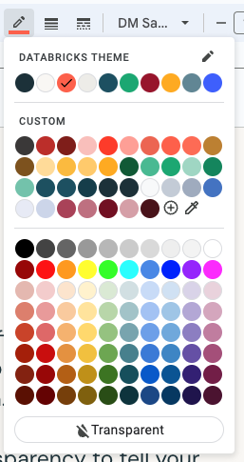
Colors
Use the Databricks Theme colors for borders, lines, and fill (but avoid the bright blue); “custom colors” are also OK if you feel you need them.
Light feeling
Use color and transparency to tell your story (group related objects, de-emphasize some object, etc) but don’t overdo it.

Slide 8
Shapes
Simple shapes, mostly rectangles
Same-sized shapes for similar concepts/objects/terms
Dotted lines or filled shapes to group objects
Dotted lines or more transparent shapes/borders/fill to de-emphasize objects

Slide 9
Flow
Left-to-right flow works well with the slide format
Top-down also works well for shorter flows
Use 1px connectors.
If there is an implied flow, use arrow endpoints

Slide 10
Connections
Use 1px connectors to imply connection or flow
If you are showing flow, use arrow endpoints; otherwise don’t
Use the purple targets when you connect shapes

Slide 11
Icons
Try to use the icons available in the corporate slide deck template, duplicated in this slide deck, below
These are very marketectury. If you need different icons, you can borrow from the internet or other slide decks, but …
All icons in a diagram should use the same line weight
All icons should be roughly the same size, unless you are suggesting hierarchy or have another good reason to vary size
If you don’t see an icon you need, talk to Leif

Slide 12
Alignment and grouping
Align shapes vertically and horizontally.
Use the centering and alignment tools available with Slides to help
Use the grouping tool to group objects that you want to move around as a unit (Right-click > group)
Use borders or filled shapes to group objects visually
Dotted-line borders can be a subtle way to visually group objects

Slide 13
Titles
Don’t use titles in the diagram itself

Slide 14
Working with Powerpoint
If you prefer to work in Powerpoint, you must import fonts and colors to your Powerpoint deck.
When you export and import slides between Powerpoint and Google Slides, formatting can often change slightly: always review the slide after it crosses a platform boundary.

Slide 15
Other resources
Borrow other people’s diagrams to save time
Review the corporate slide deck
Search these assets for diagrams that tell the story you want to tell or that can function as good templates:
Blogs
Databricks Academy slides/videos
Slide decks (PM/PMktg/Field have lots)
If you can’t find the original Slides source, ask the authors or curriculum developers of the content you want to borrow from.
The Corporate Slide Deck has the latest colors and icons. It also discusses good general design guidelines.
You’ll find it at the top of your Google Slides homepage.

Slide 16
Color guidance
Keep it on brand
When customizing charts or adding other visual elements, do your best to stay within our defined brand color palette. This will ensure that all your content looks great together and doesn’t clash with the slide template design.
1B3139
801C17
7D5319
095A35
4A121A
143D4A
BD2B26
BD802B
00875C
730D21
1B5162
FF3621
FFAB00
00A972
98102A
618794
FF5F46
FCBA33
42BA91
AB4057
A0ACBE
FF9E94
FFCC66
70C4AB
BF7080
C4CCD6
FABFBA
FFDB96
9ED6C4
D69EA8

Slide 17
Resources: Logos

Slide 18







Logos
Databricks Logos

Slide 19








Logos
Open Source Logos

Slide 20



















Logos
Partner Logos

Slide 21
Resources: Icons and illustrations

Slide 22






Icons
High Level Icons
Simple
Open
Collaborative
Training
Support
Professional Services

Slide 23














Icons
Industry Icons
Advertising and marketing technology
Communication service providers
Education
Energy and utilities
Enterprise technologyand software
Federal government
Financial services
Gaming
Healthcare
Life sciences
Manufacturing
Media and entertainment
Retail and consumer goods
State and local government

Slide 24


















Icons
Platform
Analytics
Business Insights
Collaborative Data Science
Data Pipelines
Enterprise Security
Full Lifecycle ML

Slide 25



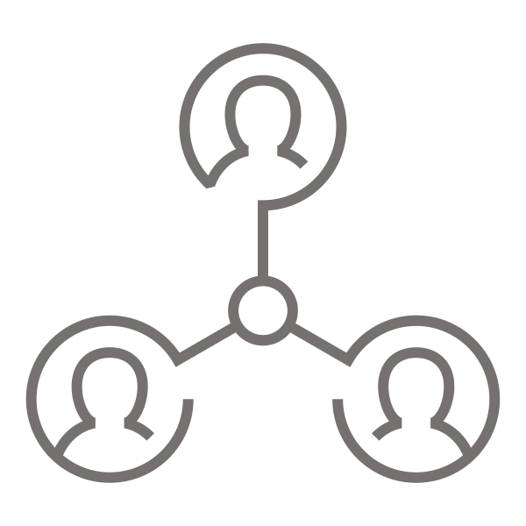



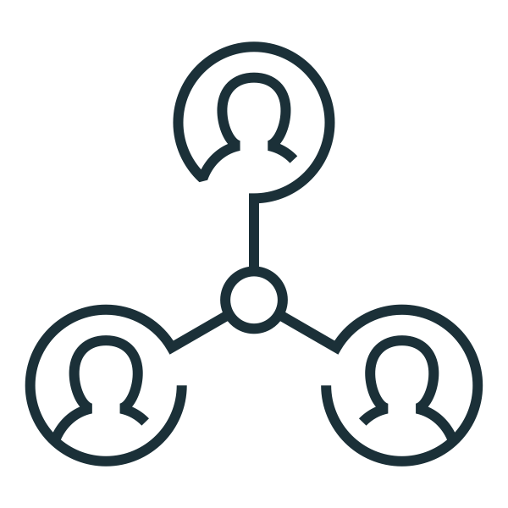



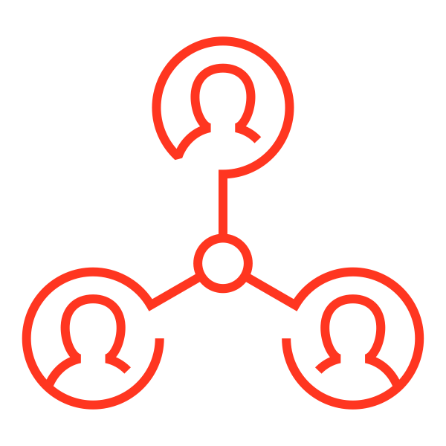
Icons
Platform (Cont.)
Analytics
Business Insights
Collaborative Data Science
Data Pipelines

Slide 26












Icons
Feature
Accelerator-Aware
Scheduler
Built-in Functions
JDK 11 Support
Join Hints

Slide 27












Icons
Monitoring
Event Log Rollover
JDBC Tab in SHS
Observable Metrics
Structured Streaming UI

Slide 28












Icons
Connectors
CSV Filter Pushdown
New Binary Data Source
New NOOP Data Source
Parquet-ORC- Nested Column Pruning

Slide 29












Icons
Performance
Adaptive Query
Execution
Dynamic Partition Pruning
40% Compiler Time Reduction
Cache Sync Reduction

Slide 30












Icons
SQL Compatibility
Overflow Checking
Proleptic Gregorian Calendar
Reserved Keywords in Parser
Store Assignment in INSERT

Slide 31












Icons
PySpark and SparkR
Eager Execution
in R Shell
New Pandas UDF
Using Type Hints
Pandas UDF
Enhancements
Vectorization in SparkR

Slide 32












Icons
Extensibility & Document
Extensibility & Document
Hadoop 3 Support
Hadoop 3 Support
SQL Reference

Slide 33












Icons
Usability and Stability
Describe Query
Dump Plan
Explain Formatted
Test Coverage

Slide 34


















Icons
Financial Services
Credit Analysis
Customer Analysis
Financial Modeling
Financial Services
Marketing Analysis
Risk/Fraud Detection

Slide 35


















Icons
Healthcare and Life Sciences
Clinical Data
Genomics
Healthcare
Medical Imaging
Medical IoT
Social Medicine

Slide 36




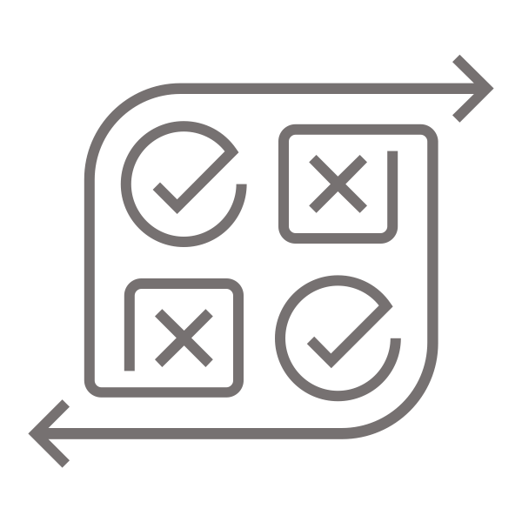





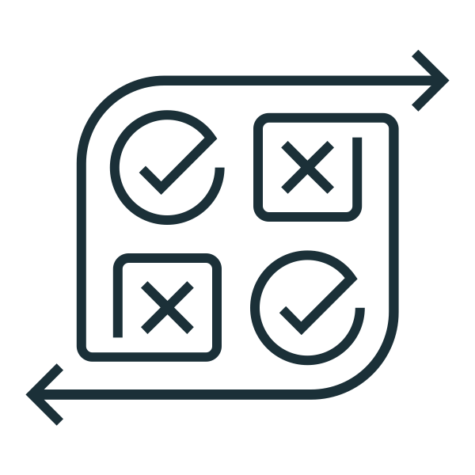





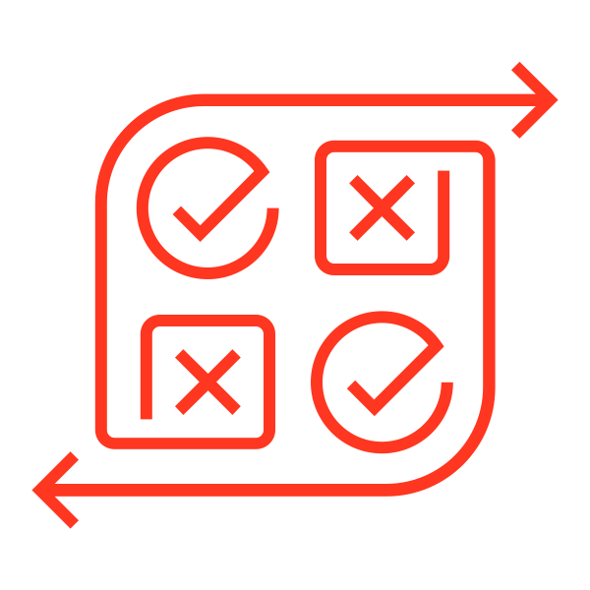

Icons
Media and Entertainment
Personalization
Churn Prevention
Media Entertainment
Predictive Analytics
Recommendations
Sentiment Analytics

Slide 37


















Icons
Retail / CPG
Data Driven Inventory
Direct to Consumer
Personalized Offers
Real-time Pricing
Retail CPG
Store Design

Slide 38





















Icons
Public Sector
Defense
Geospatial
Predictive Maintenance
Public Safety
Government
Smart meters
Smart Social Services

Slide 39
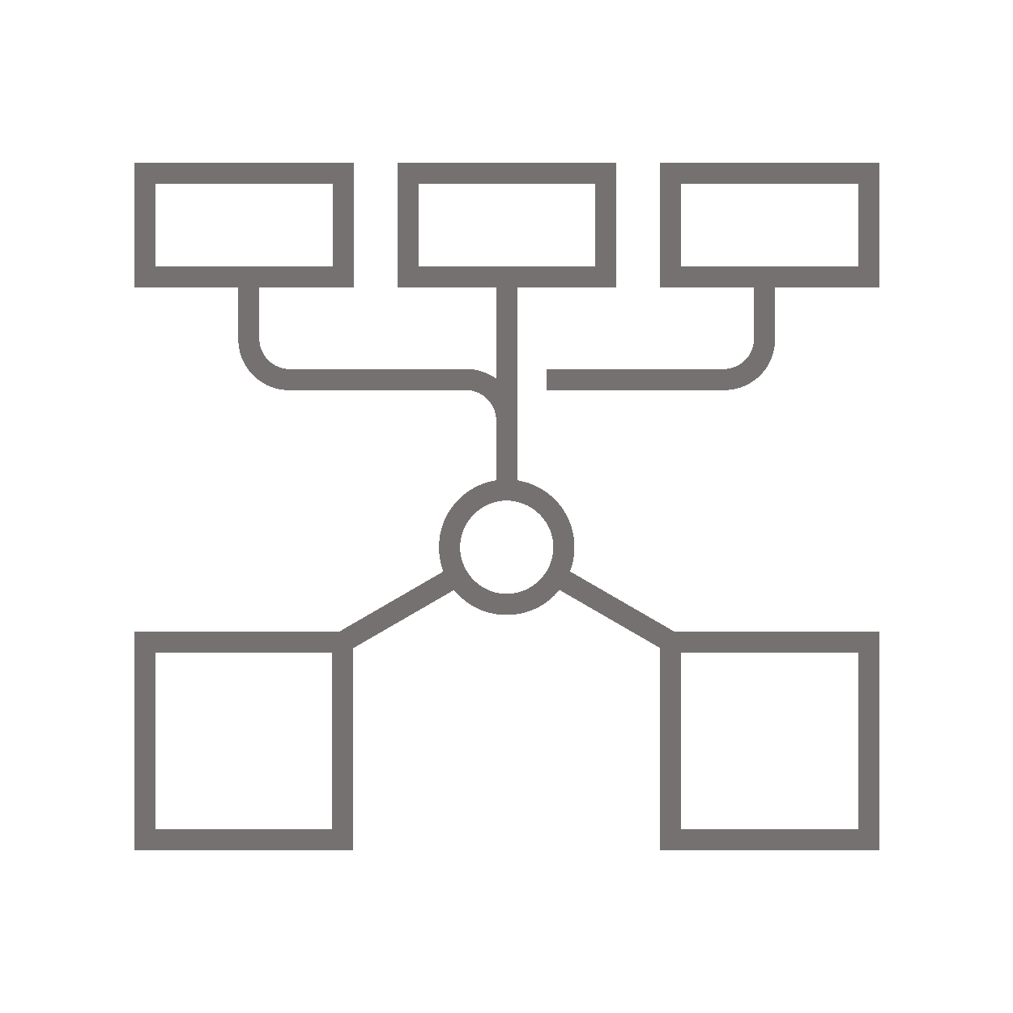






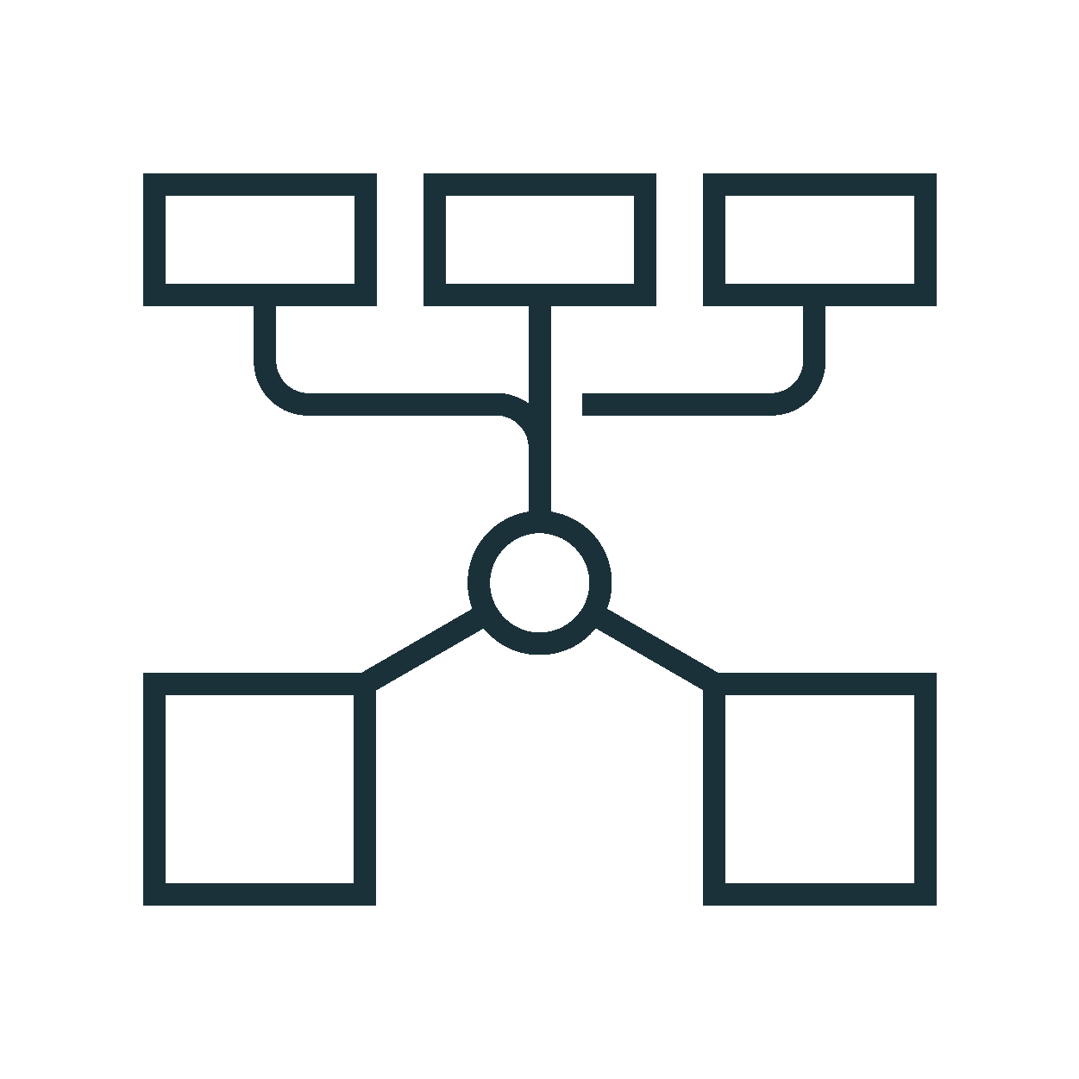






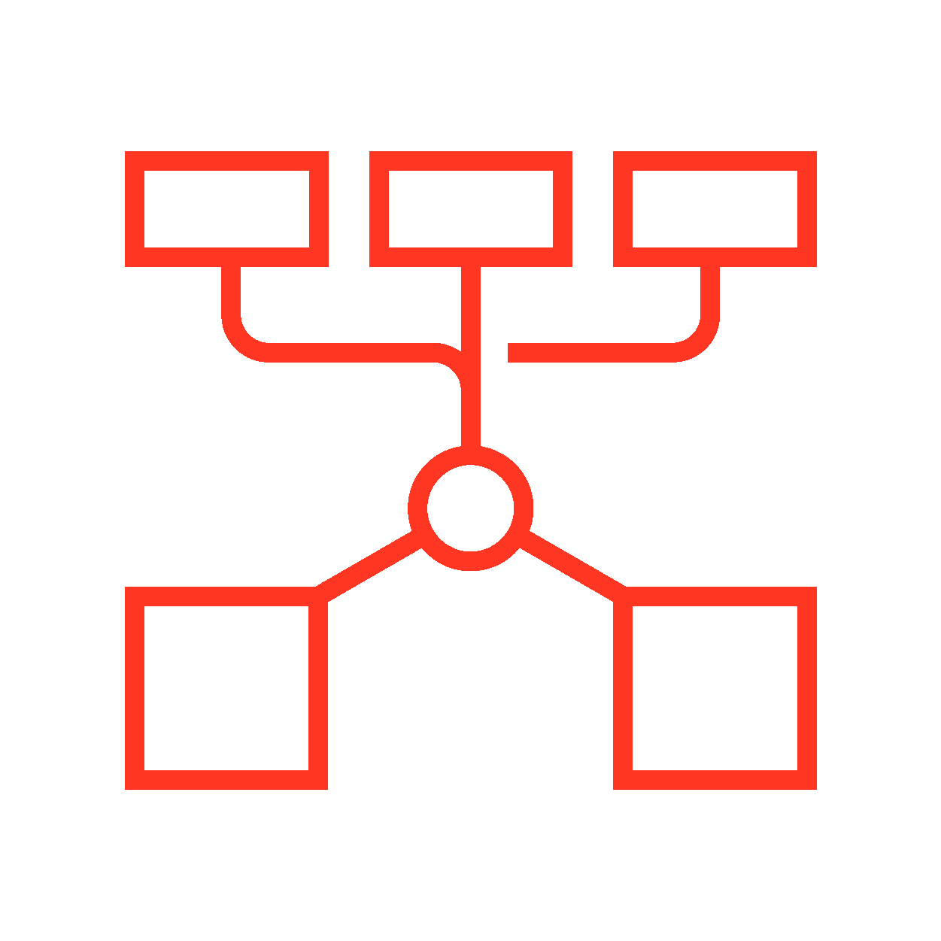






Icons
Platform Technologies
Cluster Load Balancer
Data Lake
Delta Engine
Delta Lake
Lakehouse
Photon
Redash-SQL Analytics

Slide 40




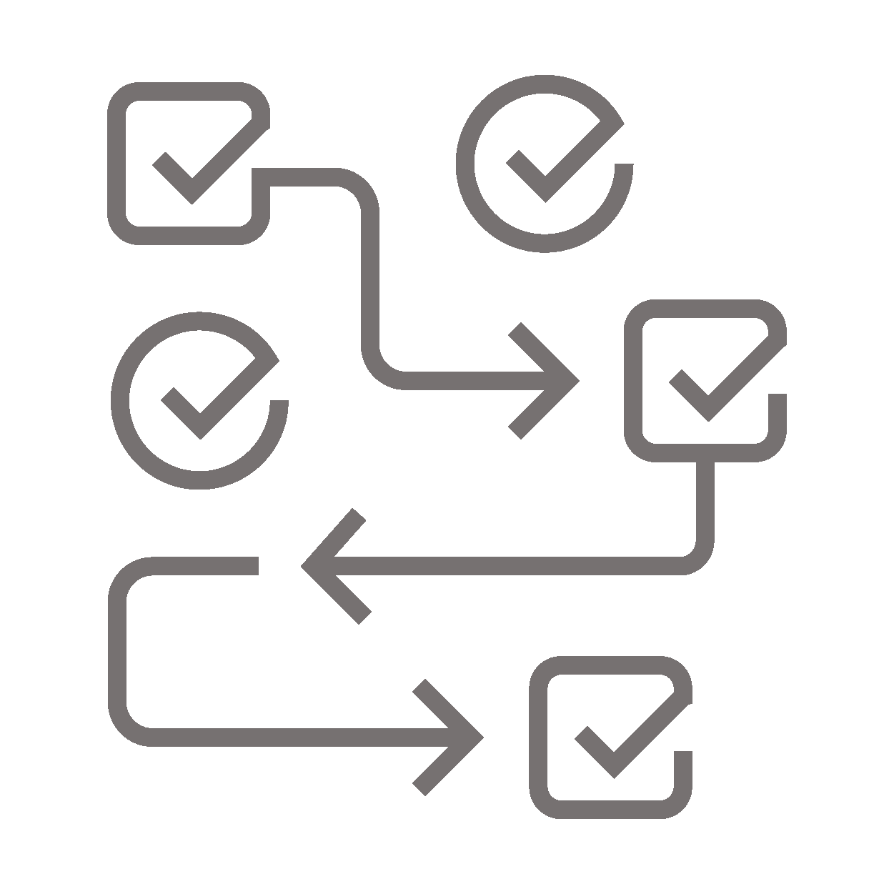






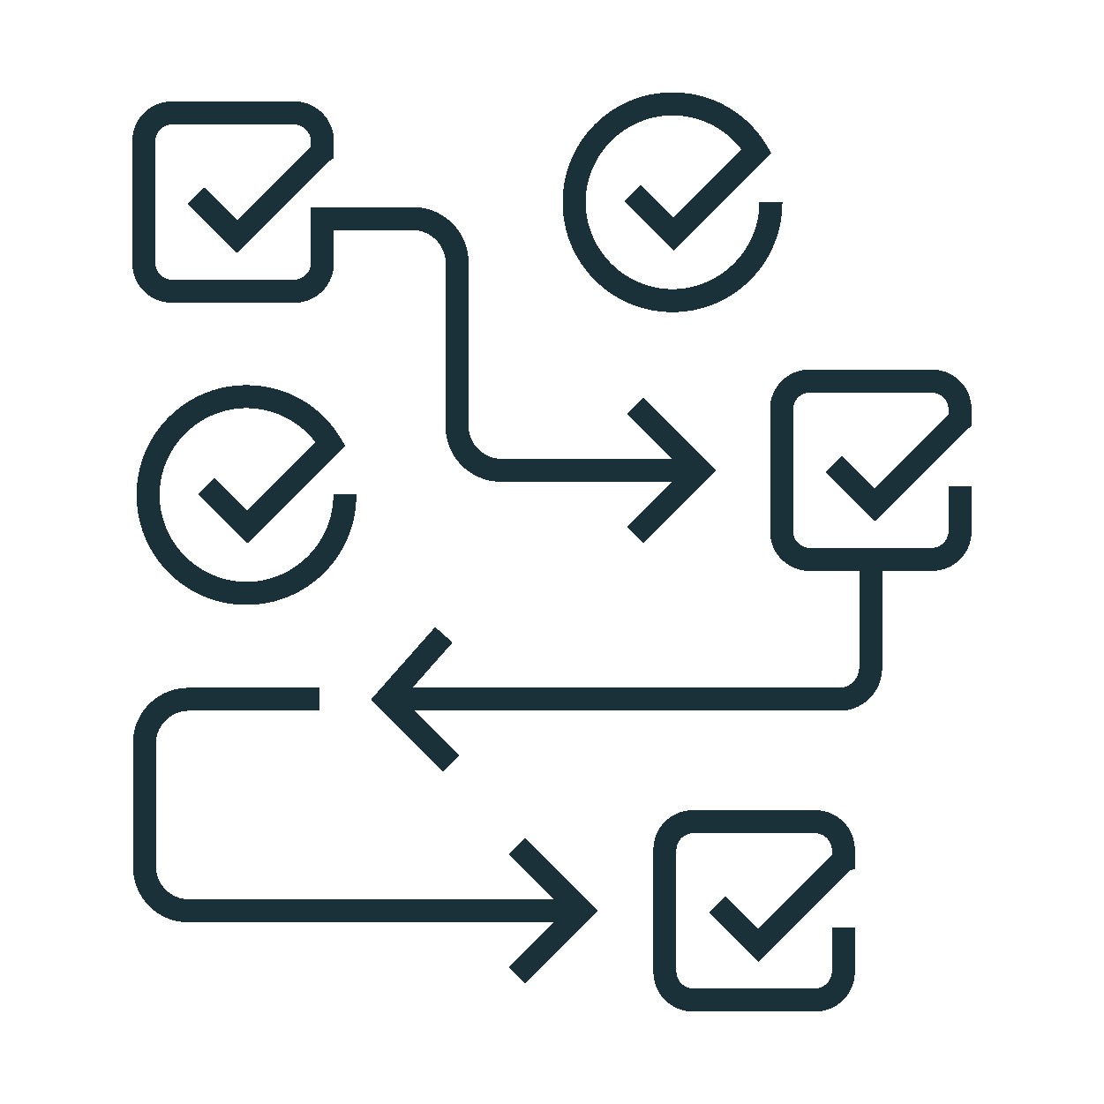






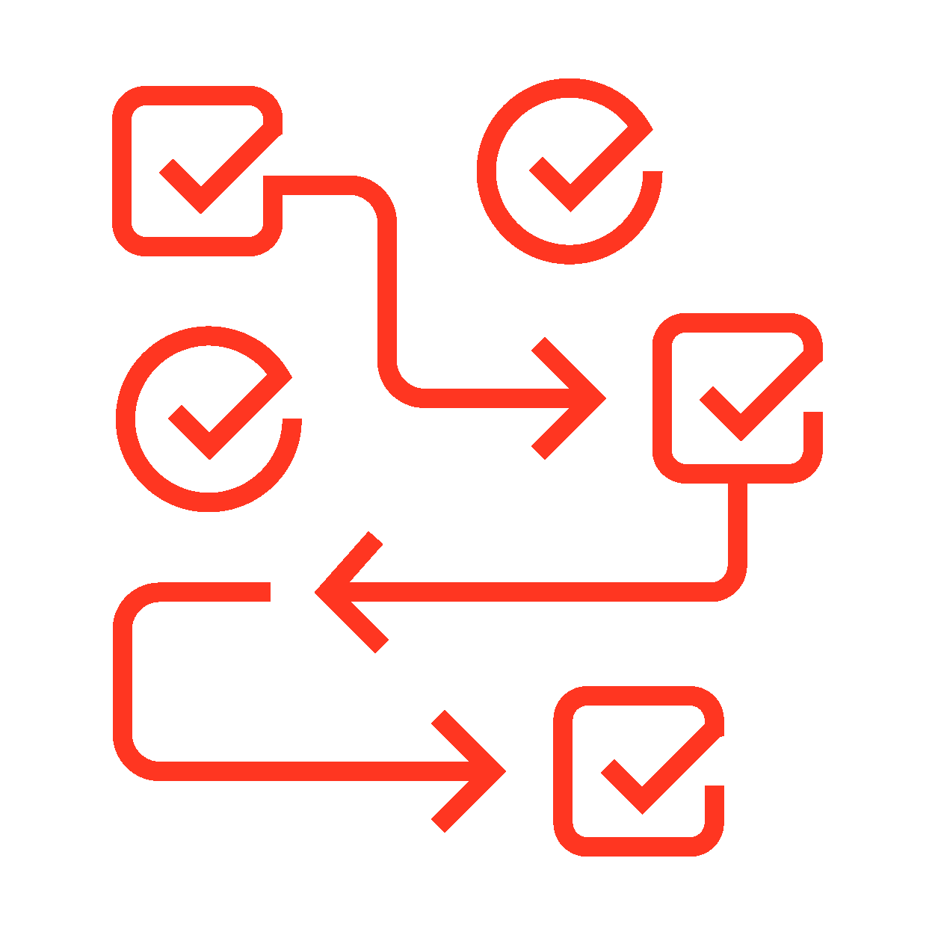


Icons
Security
Analytics
Apps Services
Attacker
Authentication Service
Automation Orchestration
Botnet
Breach

Slide 41





















Icons
Security (Cont.)
Business Risk
Cloud Security
Cloud Storage
Compliance
Context-Enrichment
Cyber Criminal
Data Parser, Normalizer, ETL-ELT

Slide 42





















Icons
Security (Cont.)
Dollars - Expense
Encryption
Endpoint
Firewall
GDPR
Identity
Incident Investigation

Slide 43





















Icons
Security (Cont.)
Insider Threat
Internet of Things
Internet
Intrusion Detection
Law Enforcement
Legal-Law Requirements
Malicious Document

Slide 44



















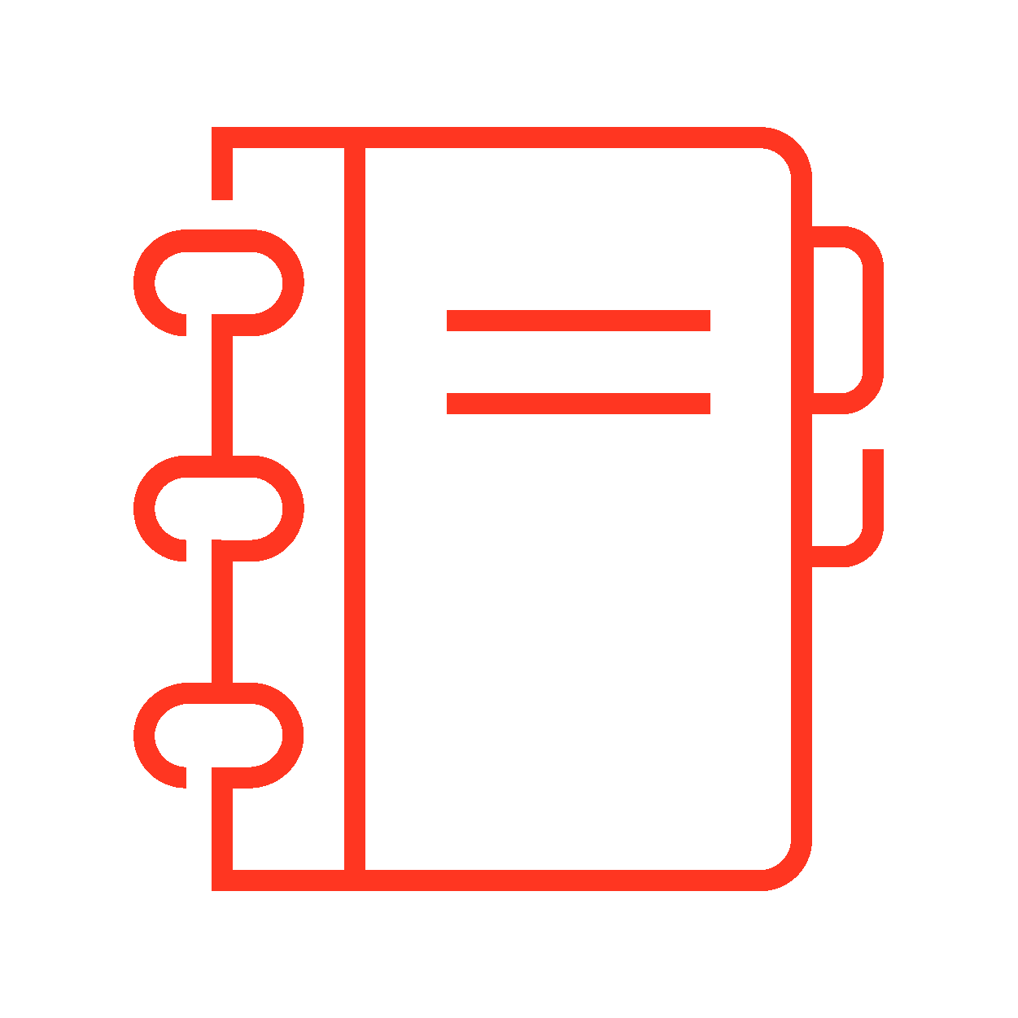

Icons
Security (Cont.)
Malware
Mobile Device
Multicloud
Nation State Attacker
Network Data Sources
Notebook
Office Building

Slide 45





















Icons
Security (Cont.)
On Prem + Cloud
(Hybrid)
Privacy
Ransomware
Reporting
Response Time
Runbook- Playbook
Security Analysts - Defenders

Slide 46


















Icons
Security (Cont.)
Security Monitoring
Security
SIEM
Threat Intelligence
Users_1
Website (www)

Slide 47




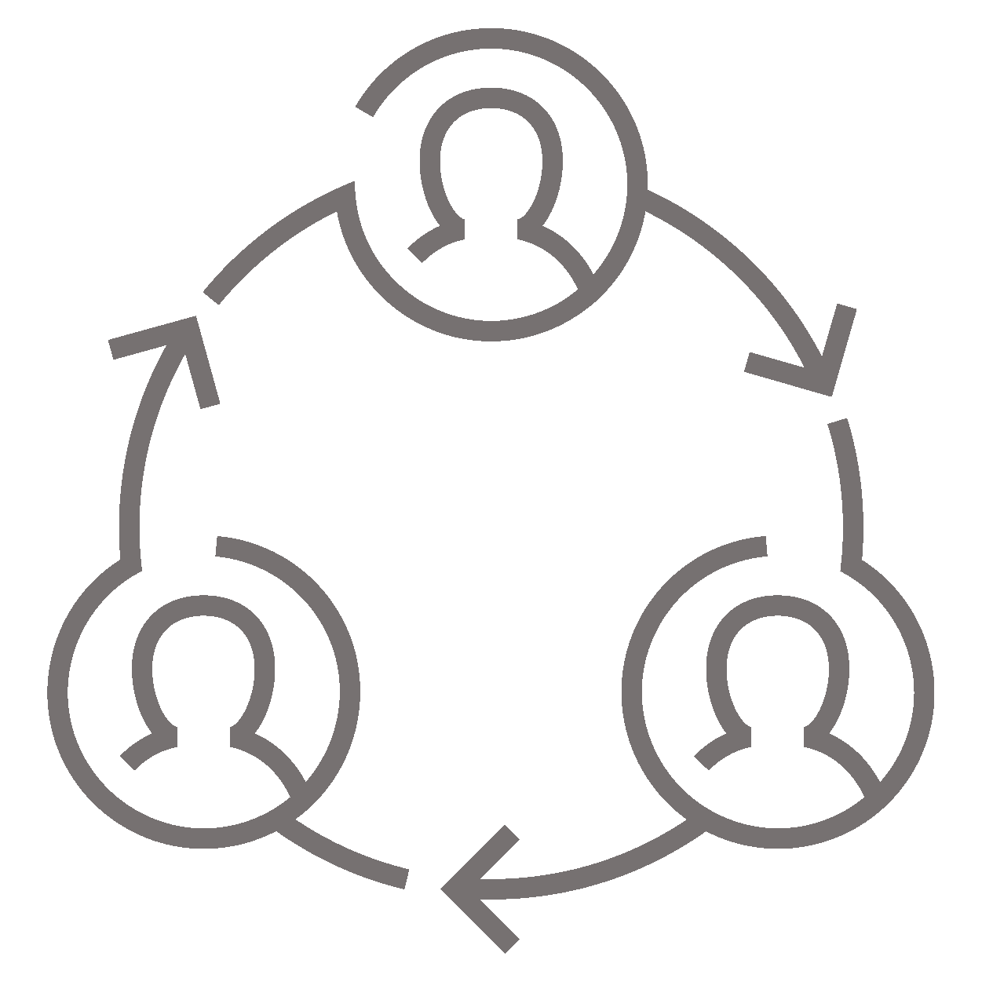
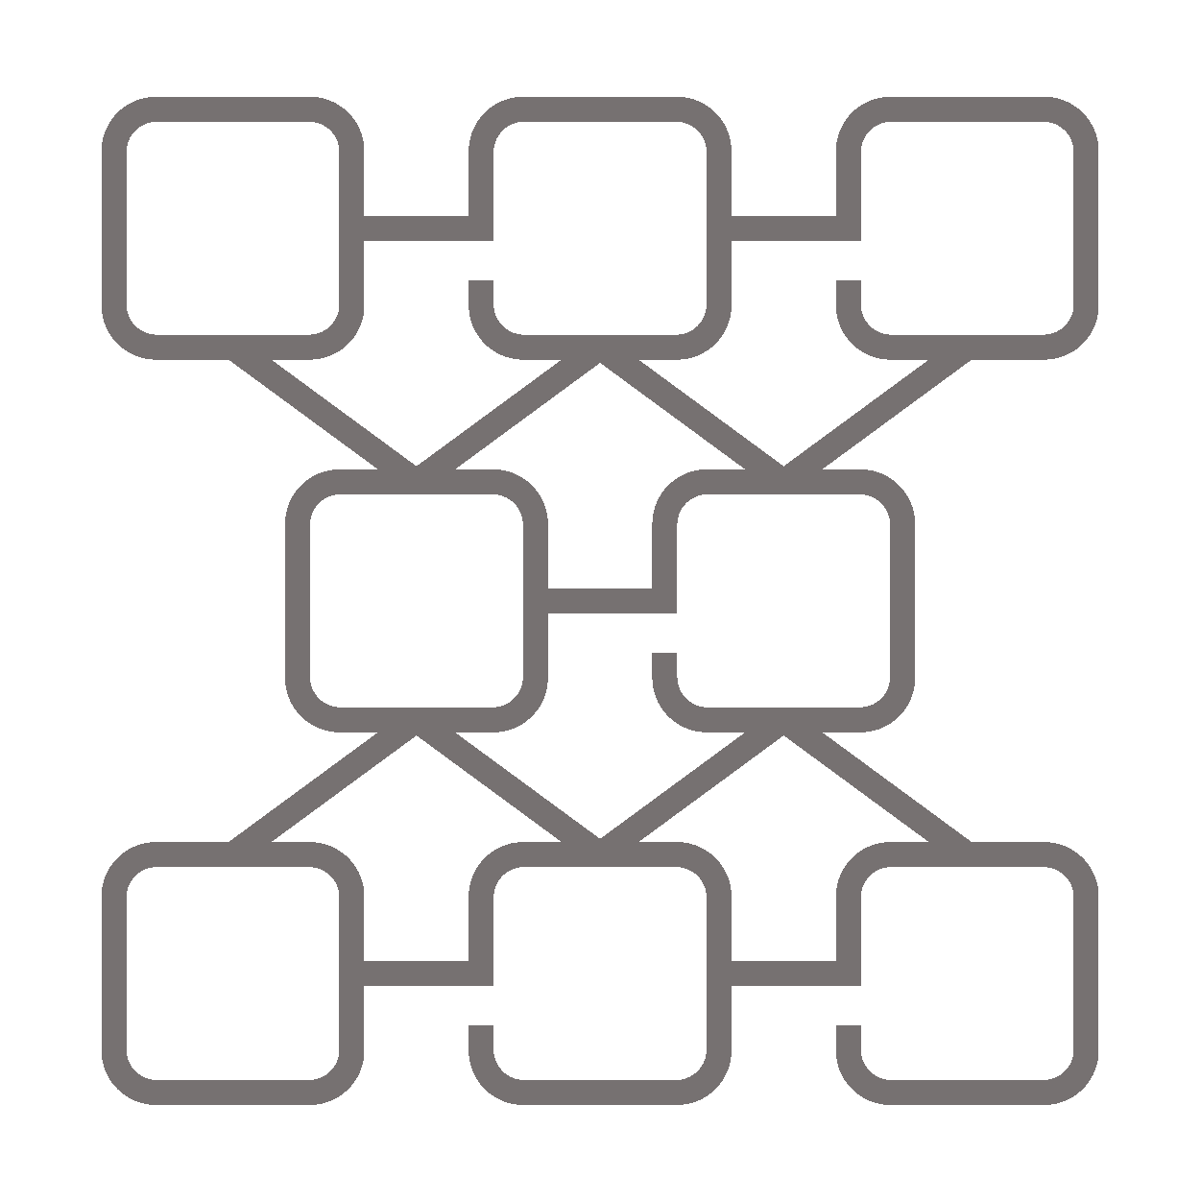




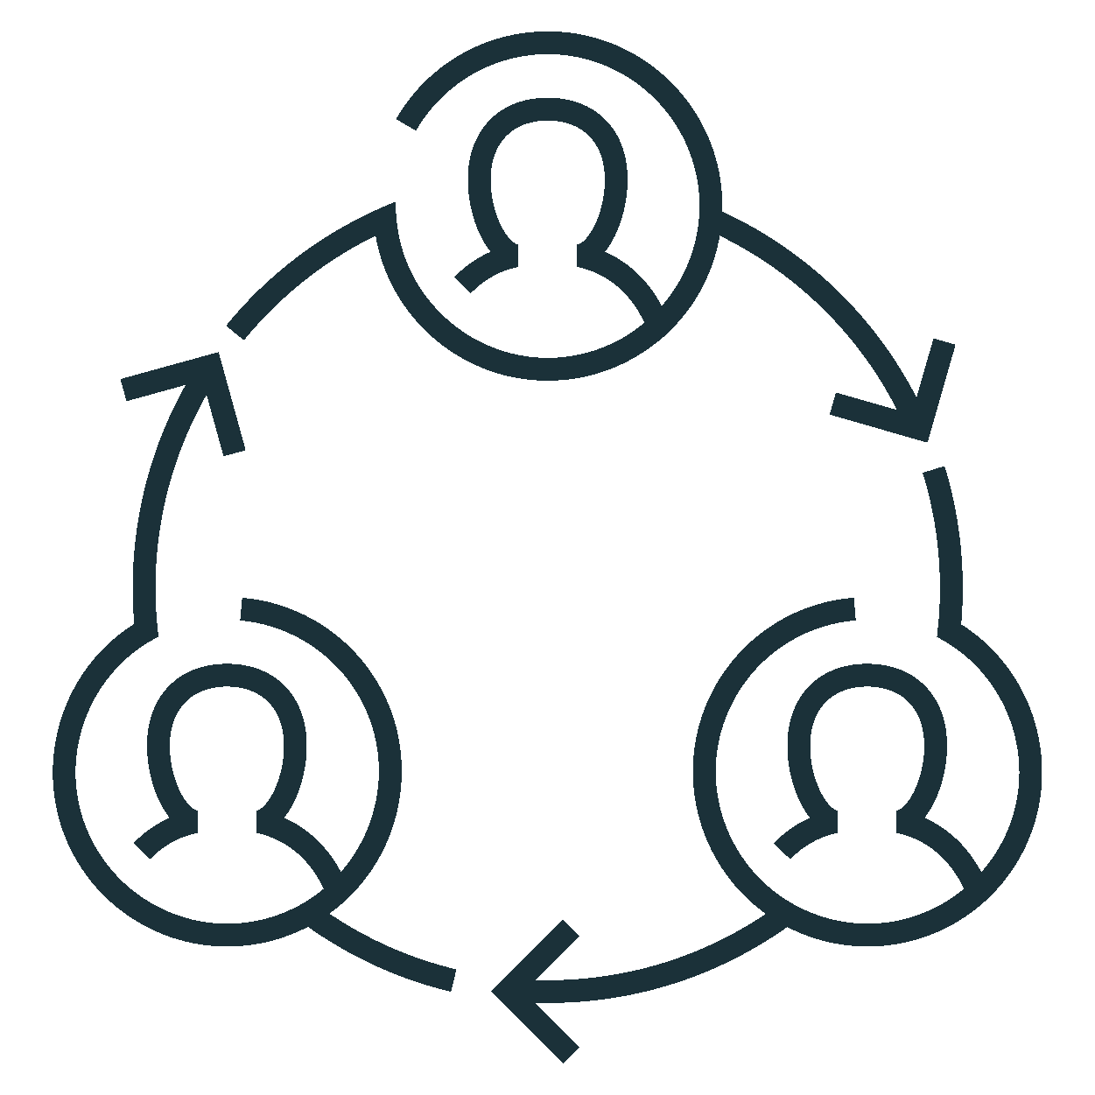
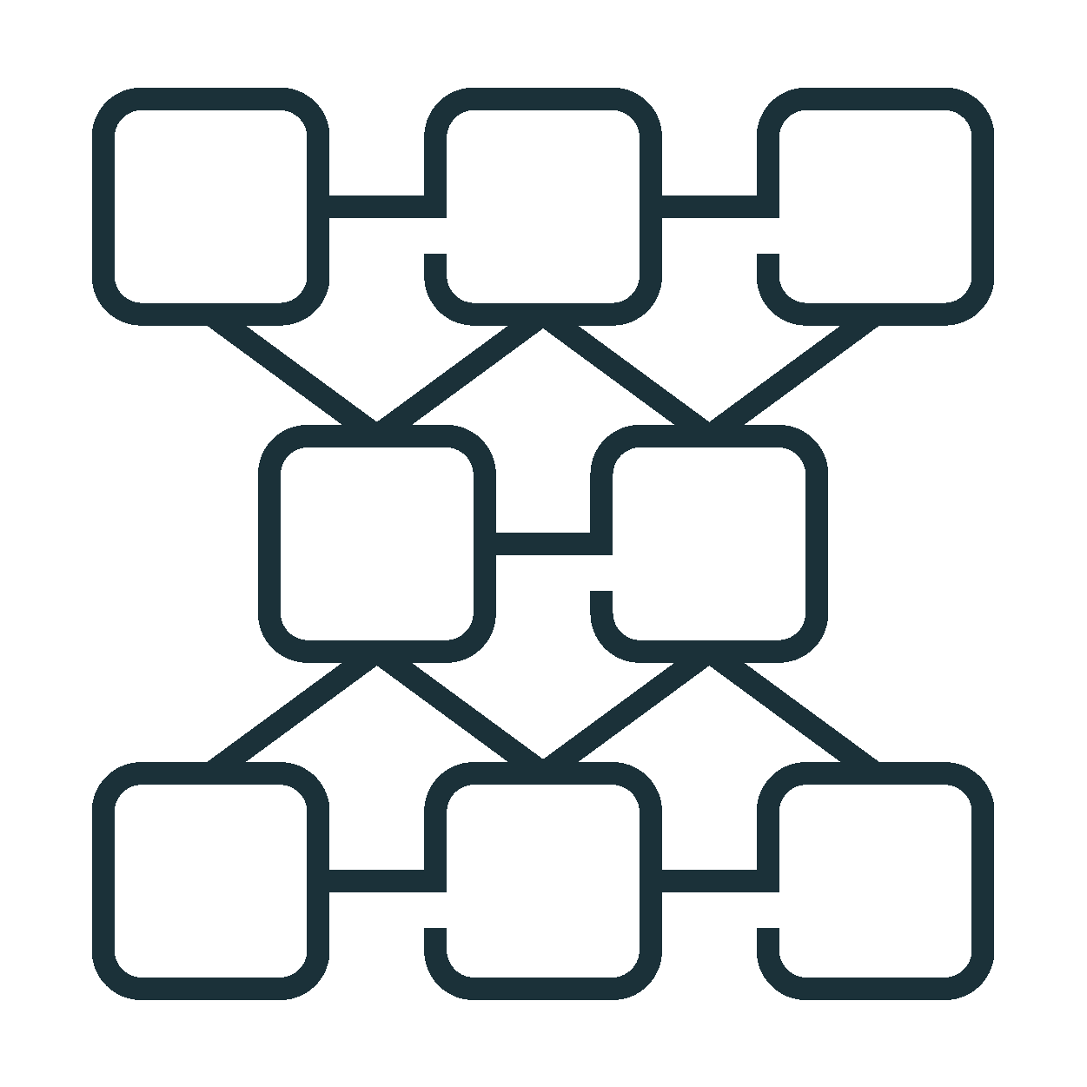




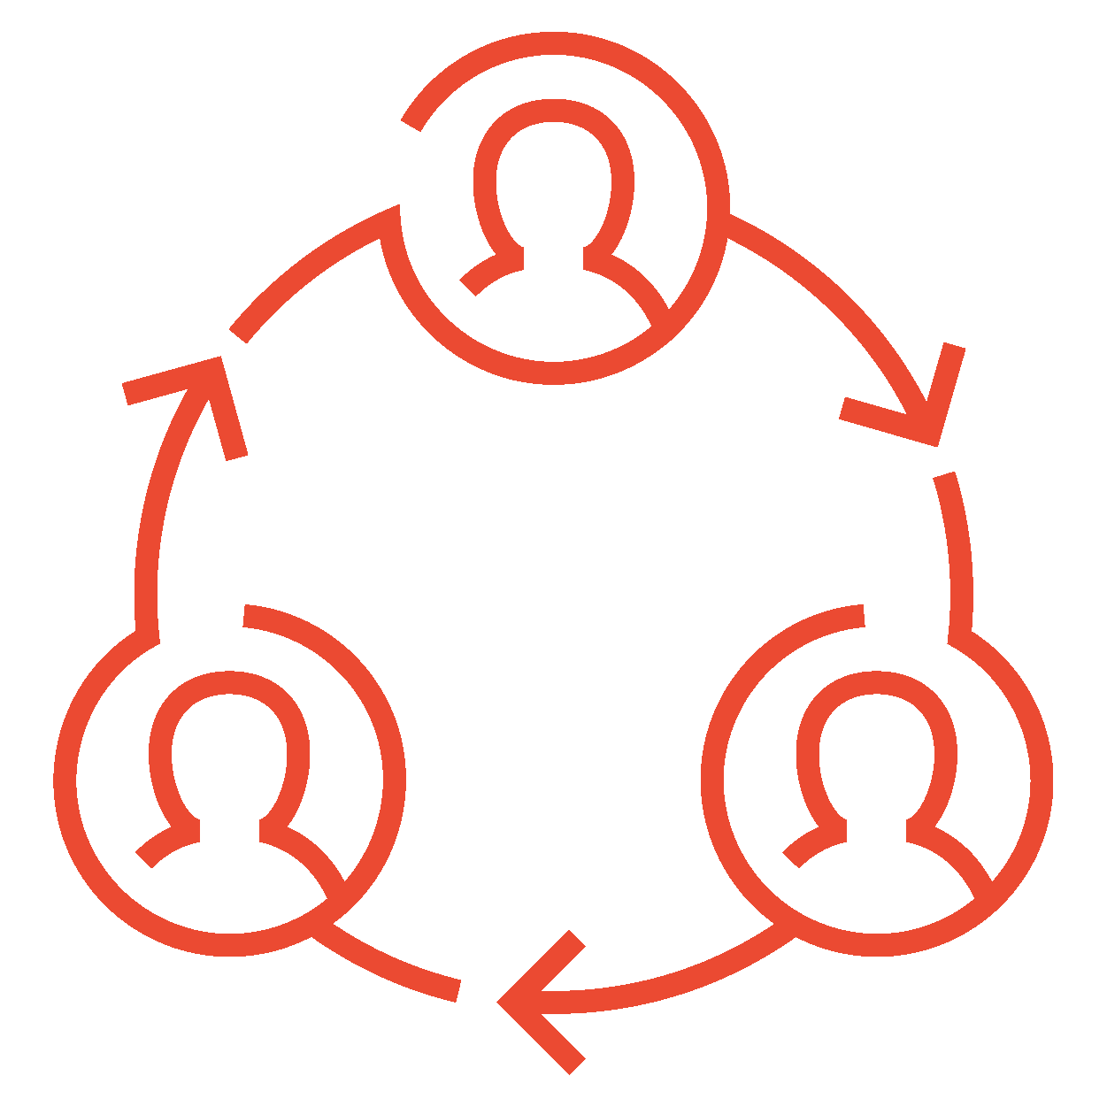
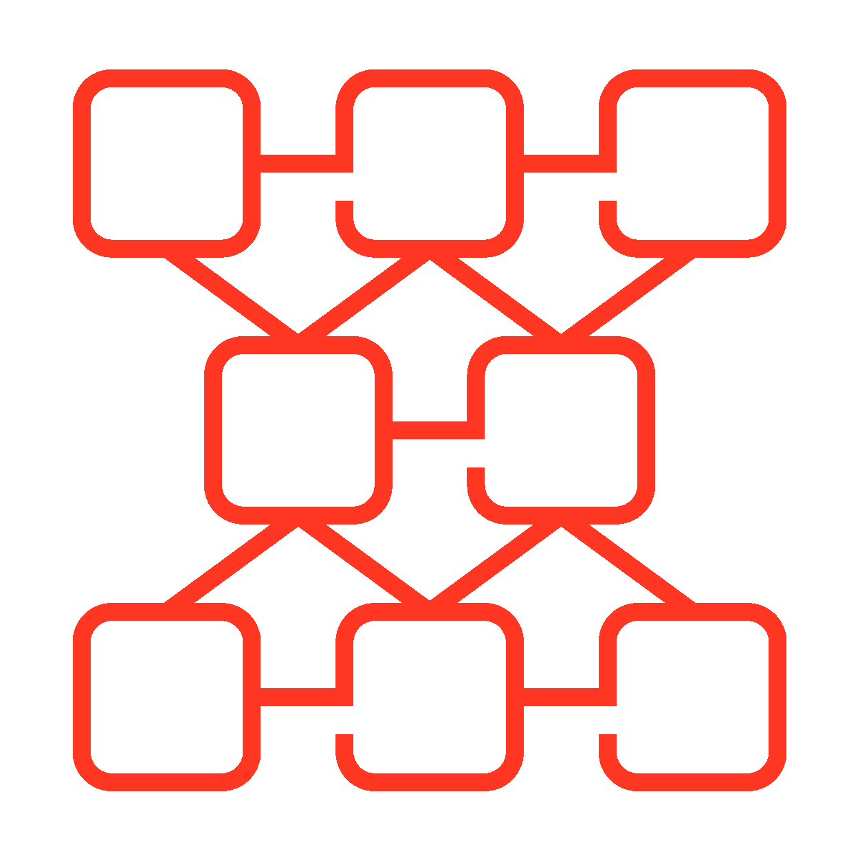
Icons
Miscellaneous
Autosize Clusters
Bronze
Business Decision
Maker Persona
Cloud
Collaborative
Connectors

Slide 48





















Icons
Miscellaneous (Cont.)
Data Analyst Persona
Data Engineer Persona
Data Scientist Persona
Databricks Usage
Databricks Workspace
Delta Table
Deploy

Slide 49





















Icons
Miscellaneous (Cont.)
ML Runtime
Notebooks
Open Source
Output
Predict
Productionize
Program

Slide 50





















Icons
Miscellaneous (Cont.)
Runtime
Scheduled Jobs
Silver
Simulator
Spark Cluster
Spark Streaming Job
Users

Slide 51












Icons
Miscellaneous (Cont.)
Gold
Hospital
Input Ingest
Admin

Slide 52






























Icons
Arrows

Slide 53
Example Diagrams

Slide 54



Managed Data Sources & External Locations
Simplify data access management across clouds
Audit log
Unity Catalog
External Locations & Credentials
Access Control
Cloud Storage (S3, ADLS, GCS)
Managed tables
Managed Data Sources
Managed container / bucket
Cluster or SQL warehouse
User
External tables
External container / bucket
…
External Locations
Files in Cloud Strg
External container / bucket
Notes:
Prior to Unity Catalog Credentials to access cloud storage like S3 or ADLS were defined at the cluster or warehouse or in a passthrough mechanism based on the user’s cloud identity.
With Unity Catalog, those Credentials live as first class primitive objects in your Unity metastore. They have ACLs on them like any other object, but they are typically not used by users directly.
When you set up a Unity Catalog Metastore for the first time, you will associate a managed data source with that metastore. This managed data source is a container or bucket that will only be read from and written to via Databricks, through Unity Catalog. Along with this managed datasource is a default credential object that will be used for Unity to broker access to this data. I will explain the request path of how Unity Catalog does this in the next slide.
But to flesh out these concepts, if you create a table in legacy HMS, and you don’t specify a location for that table, it by default will be stored in DBFS. This is known as a managed table in Hive and the default location in Databricks is DBFS.
In Unity, this is very similar, we have a concept of a managed table. that when you create a table without a specified location, it will use the managed data source associated with your metastore to store the table. Managed tables have to be Delta Tables.
There is another first class primitive object within Unity called an External Location. An External Location is a combination of two things, a cloud URL and a Credential. It is an object that can have it’s own ACLs on it and allows users to READ/WRITE or CREATE TABLEs inside it. This is how users can get access to arbitrary files in cloud storage.
If you create a table using a location that belongs to an external location that you have the CREATE TABLE right on, you can now federate this externally defined table to anywhere in your metastore hierarchy. External tables can be delta, parquet, avro, orc, or a number of other supported formats.

Slide 55






Lineage flow - How it works
ETL / Job
Explore lineage in UI
Workspace cluster / SQL Warehouse
Lineage service
Table and column lineage
Ad-hoc
Alation
FY23Q4
Microsoft Purview
Collibra
DLT
External Catalogs
Code (any language) is submitted to a cluster or SQL warehouse or DLT* executes data flow
Lineage service analyzes logs emitted from the cluster, and pulls metadata from DLT
Assembles column and table level lineage
Presented to the end user graphically in Databricks
Lineage can be exported via API and imported into other tool
Notes:
So let’s talk a bit about how Lineage actually works.
So a user submits a job or code, to a cluster or warehouse, every sql select or spark operation eventually results in sequences of Transformations or Actions, like map or read etc.
Before spark goes off and parallelizes these operations to its worker nodes, it creates something called a LogicalPlan. This is an abstraction of all transformations, in a linked graph form. The metadata of this object get submitted to a lineage service, this runs in the control plane. This service assembles all of these logical plans for all commands together to create lineage graphs that then get boiled down into tabular information about what tables fed into other tables and what columns fed into other columns. This allows you to see things like upstream and downstream consumers of any particular table or column.
This is then exposed to our UI to see that pretty graph you saw on the previous screen and also exposed through our REST APIs to support integrations with Catalog products like Alation, Collibra, and Microsoft Purview.

Slide 56
Table samples
Table Header 1 | Table Header 2 | Table Header 3
Table Content | Table Content | Table Content
Table Content | Table Content | Table Content
Table Content | Table Content | Table Content
Table Header 1 | Table Header 2 | Table Header 3 | Table Header 4 | Table Header 5 | Table Header 6
Table Content | Table Content | Table Content | Table Content | Table Content | Table Content
Table Content | Table Content | Table Content | Table Content | Table Content | Table Content
Table Content | Table Content | Table Content | Table Content | Table Content | Table Content

Slide 57
Timeline style one
Your subtitle here
Timeline Item A
Timeline Item B
Timeline Item C
Timeline Item D
Date or time
Date or time
Date or time
Date or time

Slide 58
Timeline style two
Your subtitle here
Timeline Item A
Timeline Item C
Timeline Item E
Timeline Item G
Timeline Item B
Timeline Item D
Timeline Item F

Slide 59
Timeline style three
Your subtitle here
Q1
Q2
Q3
Q4
Your gantt chart item
Your gantt chart item
Your gantt chart item
Your gantt chart item
Your gantt chart item
Your gantt chart item
Your gantt chart item
Your gantt chart item

Slide 60
Docs diagrams
These are diagrams that are actually published in the docs

Slide 61
Unity Catalog complete object model: source/_static/images/unity-catalog/object-hierarchy.png
Metastore
Service credential
Storage credential
External location
External metadata
Catalog
Connection
Share
Recipient
Provider
Clean Room
Schema
Table
View
Volume
Function
including models

Slide 62
Unity Catalog complete object model: source/_static/images/getting-started/object-hierarchy.png
Account
Metastore A
Workspace 1
Workspace 2
Workspace 3
Metastore B

Slide 63
Unity Catalog object model, focus on data objects source/_static/images/unity-catalog/object-model.png
Metastore
Service credential
Storage credential
External location
External metadata
Catalog
Share
Recipient
Provider
Connection
Clean Room
Schema
Table
View
Volume
Function
including models

Slide 64
Unity Catalog object model, focus on schema source/_static/images/unity-catalog/object-model-schema.png
Metastore
Storage credential
External location
Catalog
Share
Recipient
. . .
Schema
Table
View
Volume
Function
Including models

Slide 65
Unity Catalog object model, focus on catalog source/_static/images/unity-catalog/object-model-catalog.png
Metastore
Storage credential
External location
Catalog
Share
Recipient
. . .
Schema
Table
View
Volume
Function
Including models

Slide 66
Unity Catalog object model, focus on table source/_static/images/unity-catalog/object-model-table.png
Metastore
Storage credential
External location
Catalog
Share
Recipient
. . .
Schema
Table
View
Volume
Function
Including models

Slide 67
Unity Catalog object model, focus on view source/_static/images/unity-catalog/object-model-view.png
Metastore
Storage credential
External location
Catalog
Share
Recipient
. . .
Schema
Table
View
Volume
Function
Including models

Slide 68
Unity Catalog object model, focus on volume source/_static/images/unity-catalog/object-model-volume.png
Metastore
Storage credential
External location
Catalog
Share
Recipient
. . .
Schema
Table
Volume
View
Function
Including models

Slide 69
/_static/images/unity-catalog/uc-catalogs.png
Catalogs
Workspaces
Groups
dev
dev_ws
Developers
staging
staging_ws
Testers
Metastore
prod
prod_ws
Analysts
bu_1_dev
bu_dev_stg_ws
BU Developers
bu_1_staging
BU Testers
bu_1_prod
bu_prod_ws
BU Users

Slide 70
/_static/images/unity-catalog/external-locations-aws.png
One storage credential for multiple external locations
External tables and external volumes
user1/
table1/
Bucket/container root
users/
user2/
table2/
/
shared/
tables/
volume1/
staging/
volume2/

Slide 71
Jobs workflow diagram
source/_static/images/workflows/jobs/example-workflow-diagram.png
Order data
Delta Live Tables
pipeline
Prepared
data
Persist features
Join order and
clickstream data
Extract features
Clickstream
data
Delta Live Tables
pipeline
Sessionized
data
Train model
Notes:
This diagram is intended to replace the diagram at the top of the jobs article and moved to a new index page for jobs.
Draft of a description for this diagram:
The following diagram illustrates a workflow that:
Runs a Delta Live Tables pipeline to ingest order data from cloud storage, clean and transform the data for processing, and persist to Delta.
Runs another Delta Live Tables pipeline to ingest clickstream data from cloud storage, clean and sessionize the data, and persist to Delta.
Joins the order and session data to create a data set for analysis.
Extracts features from the prepared data.
Performs tasks in parallel to persist the features and train a machine learning model.

Slide 72
/_static/images/files/posix-paths.png
Volumes
<catalog_name>
<schema_name>
<volume_name>
Mounts
mnt
<mnt_name>
dbfs
DBFS root
/
/
Workspace files
Users
<user_folder>
Workspace
Shared
Repos
<user_folder>
Ephemeral driver-attached storage

Slide 73
/_static/images/files/uri-paths-aws.png
Volumes
<catalog_name>
<schema_name>
<volume_name>
Mounts
dbfs:/
mnt
<mnt_name>
DBFS root
Workspace files
Users
<user_folder>
file:/
Workspace
Shared
Repos
<user_folder>
s3://
<bucket_name>

Slide 74
/_static/images/files/uri-paths-azure.png
Volumes
<catalog_name>
<schema_name>
<volume_name>
Mounts
dbfs:/
mnt
<mnt_name>
DBFS root
Workspace files
Users
<user_folder>
file:/
Workspace
Shared
Repos
<user_folder>
abfss://
<container_name>@<storage_account_name>.dfs.core.windows.net

Slide 75
/_static/images/files/uri-paths-gcp.png
Volumes
<catalog_name>
<schema_name>
<volume_name>
Mounts
dbfs:/
mnt
<mnt_name>
DBFS root
Workspace files
Users
<user_folder>
file:/
Workspace
Shared
Repos
<user_folder>
gs://
<bucket_name>

Slide 76
Three-level hierarchy of managed table/volume storage
/_static/images/unity-catalog/managed-storage.png
Unity Catalog
Cloud storage (S3, ADLS2, GCS)
Metastore
Managed storage location
Metastore-level storage
Catalog 1
Schema 1
Catalog 2
Managed storage location
Catalog-level storage
Schema 2
Schema-level storage
Schema 3
Managed storage location

Slide 77
Metastore-level vs catalog-level ownership
/_static/images/unity-catalog/ownership.png
Metastore
Catalog 1
Catalog 2
Schema 1
Schema 2
Schema 3
Catalog 1 owner
Catalog 2 owner
Metastore admin (optional)

Slide 78


Networking classic compute plane and serverless compute plane
/_static/images/security/network/networking-classic-serverless.png
Your Databricks account
Control plane
Web application
Your cloud account
Compute orchestration
Classic compute workloads
2
Unity Catalog
Compute
Compute
Users and applications
1
Queries and code
Serverless workloads
Your resources
Compute
Compute
3

Slide 79
Networking classic compute plane
/_static/images/security/network/networking-classic.png
Your Databricks account
Control plane
Your cloud account
Users and applications
Web application
Your resources
Compute orchestration
Classic compute workloads
1
2
Compute
Compute
Unity Catalog
Queries and code

Slide 80
Networking serverless compute plane
/_static/images/security/network/networking-serverless.png
Your Databricks account
Control plane
Web application
Users and applications
Your resources
Compute orchestration
Serverless workloads
1
2
Compute
Compute
Unity Catalog
Queries and code

Slide 81

Unity Catalog workspace high-level diagram, comparison with non-UC workspace
/_static/images/unity-catalog/with-unity-catalog.png
Without Unity Catalog
With Unity Catalog
Databricks Workspace
Databricks Workspace
Unity Catalog
User Management
Metastore
User Management
User Management
Databricks Workspace
Databricks Workspace
Metastore
Metastore
Compute
Compute
Compute
Compute

Slide 82
High-level architecture
/_static/images/getting-started/architecture.png
Your Databricks account
Control plane
Web application
Your cloud account
Compute orchestration
Classic compute plane
Unity Catalog
Compute
Compute
Users and applications
Queries and code
Serverless compute plane
Your resources
Compute
Compute

Slide 83
High-level architecture
/_static/images/getting-started/architecture.png
Your Databricks account
Control plane
Web application
Your cloud account
Classic compute plane
Workspace storage bucket
Compute orchestration
Compute
Users and applications
Unity Catalog
Compute
Queries and code
Serverless compute plane
Your resources
Compute
Compute

Slide 84
High-level architecture
/_static/images/getting-started/architecture-gcp.png
Your Databricks account
Control plane
Web application
Your cloud account
Classic compute plane
Workspace storage buckets
Compute orchestration
Compute
Users and applications
Unity Catalog
Compute
Queries and code
Serverless compute plane
Your resources
Compute
Compute

Slide 85
High level arch with serverless workspaces
/_static/images/getting-started/serverless-workspaces.png
Your Databricks account
Control plane
Web application
Compute orchestration
Unity Catalog
Users and applications
Queries and code
Your cloud account
Serverless compute plane
Storage buckets
Compute
Compute
Default storage

Slide 86
RAG LLMOps lifecycle overview
/_static/images/generative-ai/llm-ops-simplified.png
LLMOps governance and lifecycle management
Iterate to improve
Gather requirements
Proof of Concept
Test with stakeholders
Agent parameters
Optimize cost / latency
Deploy to production
Monitor in production
MLflow
Review App
Agent metrics
Agent serve
LLM judges
Agent trace
Evaluate & monitor quality, cost, & latency
Agent trace
LLM judges
Agent metrics

Slide 87
RAG development & LLMops lifecycle
/_static/images/generative-ai/development-lifecycle.png
RAG development: Evaluation-driven workflow
Iterate to improve
Agent parameters
Gather requirements
Proof of Concept
Test with stakeholders
Measure baseline quality
Optimize cost / latency
Deploy to production
Monitor in production
MLflow
Review App
RAG metrics
Agent metrics
Agent serve
LLM judges
LLM judges
Agent trace
Agent trace
Evaluate & monitor quality, cost, & latency
Agent trace
LLM judges
Agent metrics

Slide 88
RAG development & LLMops lifecycle
/_static/images/generative-ai/development-lifecycle.png
AI agent development lifecycle
Iterate to improve
Agent metrics
Prepare data
Create agent tools
Build prototype
Label evaluation data
Agent trace
Collect feedback
Deploy to production
Monitor in production
Model versioning
ETL pipeline
Unity Catalog functions
AI Playground
Agent Evaluation
Review App
Model Serving
Evaluation job
Agent Framework
LLM judges
Synthetic data
MLflow tracking

Slide 89
RAG application
RAG Chain workflow
/_static/images/generative-ai/rag-agent-workflow.png
User
Query
Application
Query preprocessing
Orchestration framework
1.
Query
Embedding model
Query embedding
Model Serving
2.
Vectorized
query
Vector
search
Vector database
Retriever
Vector Search
Orchestration framework
3. Retrieval
Relevant content
Combine
query & relevant content
4. Augmentation
Augmented
query
LLM
Model Serving
5. Generation
Response
User
Response
Application
Post processing
Orchestration framework
6.

Slide 90
RAG indexing pipeline /_static/images/generative-ai/rag-data-pipeline.png
RAG chain
Query submission
Data
pipeline
Ingestion
Document processing
Embedding
Storage
Vector database
Query embedding
Vector
search
Delta Table
Workflows
Workflows
Delta Table
Vector Search
Retrieval phase
Volumes
Delta Live Tables
Delta Live Tables
Relevant content
Notebooks
Notebooks
Augmentation
Model Serving
Generation
Response handling

Slide 91
Chunk relevance precision /_static/images/generative-ai/retrieved-chunks-precision.png
Retrieved chunks
Relevant
doc_uri: doc1
content: …
chunk_id: chunk1
Relevant
chunk_relevance/precision
doc_uri: doc1
content: …
chunk_id: chunk10
relevant chunks returned
3
=
=
75%
Relevant
total chunks returned
4
doc_uri: doc2
content: …
chunk_id: chunk1
Not relevant
doc_uri: doc3
content: …
chunk_id: chunk6

Slide 92
Ground truth document recall /_static/images/generative-ai/ground-truth-document-recall.png
Retrieved chunks
Relevant
doc_uri: doc1
content: …
chunk_id: chunk1
Relevant
ground_truth/document_recall
Ground truth relevant docs:
doc_uri: doc1
content: …
chunk_id: chunk10
relevant docs returned
2
doc1
doc2
=
=
100%
Relevant
total relevant docs
2
doc_uri: doc2
content: …
chunk_id: chunk1
Not relevant
doc_uri: doc3
content: …
chunk_id: chunk6

Slide 93


Agentic diagrams /_static/images/generative-ai/llms.png, /_static/images/generative-ai/llm-tools.png, /_static/images/generative-ai/ai-agent.png , /_static/images/generative-ai/multi-agent-system.png
User
LLM
Large Language Models (LLM)
User
LLM
Parse
query
Retrieve related docs
Augment prompt
Generate response
LLMs + hardcoded tools
User
LLM + Tools + Planning
AI agent
User
Coordinator
Worker
agents
Multi-agent system

Slide 94
Agentic diagrams /_static/images/generative-ai/llms.png, /_static/images/generative-ai/llm-tools.png, /_static/images/generative-ai/ai-agent.png , /_static/images/generative-ai/multi-agent-system.png
Create agent tools as Unity Catalog functions.
Build an AI agent using any framework.
Framework-agnostic AI agent
Unity Catalog functions
Standardize the agent using the ChatAgent interface
+
ChatAgent
Log the agent using MLflow to package it for deployment
+
ChatAgent
Multi-agent system

Slide 95
Agentic diagrams /_static/images/generative-ai/llms.png, /_static/images/generative-ai/llm-chain.png, /_static/images/generative-ai/agentic-vs-compound-ai-systems.png
Compound AI systems
Agentic applications

Slide 96
RAG evaluation workflow
Eval set
catalog.schema.eval_table
LLM judge outputs
catalog.schema.eval_table_assessments
3
evaluate(...)
Dashboard
MLflow
4
Answer table
catalog.schema.answer_table
Metric computations
catalog.schema.eval_table_eval_metrics
1
2
ETL logs
Your RAG app
Legend:
Delta table
API

Slide 97
A
Review app
B
C
/feedback
/invocations
Model serving endpoint
Inference table
D
Request log
Assessment log

Slide 98
C
E
B
Review app
Customer front-end app
Review app
D
F
A
/feedback
/invocations
Model serving endpoint
Inference table
G
Request log
Assessment log

Slide 99




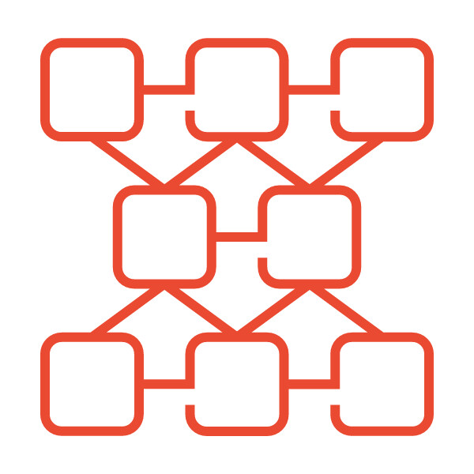


External identity provider
Databricks Account SCIM APIs
Your Databricks account
All account users
User 1
User 2
Group 1
Group 2
Group 3
Databricks Workspace A
Databricks Workspace B
Databricks Workspace C
Dashboard
Dashboard
Dashboard
Dashboard
Dashboard
Dashboard
Notes:
source/_static/images/dashboards/lakeview-acct-sharing.png

Slide 100
Azure active directory
Databricks seamless onboarding or Account SCIM APIs or
Your Databricks account
All account users
User 1
User 2
Group 1
Group 2
Group 3
Databricks Workspace A
Databricks Workspace B
Databricks Workspace C
Dashboard
Dashboard
Dashboard
Dashboard
Dashboard
Dashboard
Notes:
source/_static/images/dashboards/lakeview-acct-sharing-azure.png

Slide 101
SSO flow chart /_static/images/sso/sso-flow.png
https://docs.google.com/drawings/d/1-EroXSICIHYmAg-NkXE9yyaW3Pk9XvZL1hO2ZcoixGM/edit
One-time passcodes via email are enabled by default
You can configure sign-in with Google or Microsoft
No
Are users managed by one identity provider?
Unified login is enabled on all workspaces by default
Yes
No
Was your account created before June 21, 2023?
Enable SSO in your account
Yes
We recommend enabling unified login on all workspaces
Notes:
source/_static/images/dashboards/lakeview-acct-sharing-azure.png

Slide 102
Data filtering on dedicated compute (fine-grained access control)
/_static/images/unity-catalog/data-filtering-single-user.png
Unity Catalog
Dedicated
compute
table_1
SELECT *
FROM table_1
SELECT *
FROM view_2
view_2
table_2
Data filtering
SELECT *
FROM table_w_rls
Serverless compute
table_w_rls

Slide 103

Notebook cell action icons
/_static/images/notebooks/notebook-cell-icons.png
Show cell actions menu
Cell focus
Databricks Assistant
Delete cell
Language selector

Slide 104


Job compute
/_static/images/jobs/job-compute1.png
Job configuration
Task 1
Task 2
Task 3
…Task N
Compute A
Compute B
‹#›

Slide 105


Bundle (DABs) lifecycle
/_static/images/asset-bundles/bundle-cicd.png
Data workers
Databricks workspaces
Development workspace
Staging workspace
Production workspace
Local dev environment
Users can manually deploy to see and test changes in dev.
dev deployment
staging deployment
production deployment
project bundle
Code and integration tests are deployed to staging.
Code is deployed to production after review and approval.
version control
CI/CD
Users can do direct edits for items that aren’t source controlled.
Users can commit changes to source control.
project repository
Notifications trigger CI/CD.
Configure service principals, kick off runs of jobs, and other tasks.
‹#›

Slide 106
Bundle (DABs) lifecycle
/_static/images/asset-bundles/bundle-cicd-small.png
Databricks workspaces
Development workspace
Staging workspace
Production workspace
Local dev environment
Build/validate bundle
project bundle
version control
CI/CD
push
project repository
Configure service principals, kick off runs of jobs, and other tasks.
Notifications trigger CI/CD.
‹#›

Slide 107
Languages overview
/_static/images/languages/data-eng-decision.png
Python, SQL
(as notebooks or files)
Delta Live Tables
What is used to execute the pipeline?
Python script
Python
Workflows
SQL file
SQL
What is the task type?
Notebook
Python, SQL, Scala
Python wheel
Python, as a wheel
JAR
Scala, Java, JVM-based languages as JAR
‹#›
‹#›

Slide 108
Databricks-hosted model for Databricks Assistant
/_static/images/databricksiq/db-hosted-model.png
3
Serverless
Databricks model serving
Production workspace
Control plane
Users
1
2
Answer / Diagnosis
(geo-based serving)
production deployment
User input
Assistant request
Model endpoint
Model endpoint
Code is deployed to production after review and approval.
Configure service principals, kick off runs of jobs, and other tasks.
‹#›

Slide 109
catalog = ops
schema = bronze
catalog = ops
schema = silver
catalog = ops
schema = gold
Bronze
Silver
Gold
Cloud storage
customers_raw
customers_ cleaned
customer_ spending
customer_ transactions
Kafka
transactions_ raw
transactions_ cleaned
business_ summary
Salesforce
accounts_raw
accounts_ cleaned
account_ performance
account_ opportunities
opportunities_ raw
opportunities_ cleaned
sales_ pipeline_ summary
leads_raw
leads_cleaned
Notes:
Medallion architecture

Slide 110
Data pipeline
raw_customers
clean_customers
Run every 2 hours
sales_report
raw_transactions
clean_transactions
Notes:
Data pipeline

Slide 111
Ingestion
Structured Streaming in notebooks
Delta Live Tables streaming tables
Platform
Apache Spark Structured Streaming
Engine
Notes:
Incremental stream processing 1

Slide 112
Transformation
Delta Live Tables materialized views
Structured Streaming in notebooks
Delta Live Tables streaming tables
Platform
Enzyme
Apache Spark Structured Streaming
Engine
Notes:
Incremental stream processing 2

Slide 113
Batch 1 input
Batch 2 input
8:15am → socks
8:30am → jacket
8:45am → shoes
9:05am → pants
Batch 1 output
Batch 2 output
[8am, 9am] → 2
[8am, 9am] → 1
[9am, 10am] → 1
Notes:
Batch transformation out-of-order

Slide 114
Batch 1 input
Batch 2 input
8:15am → socks
8:15am → socks
8:45am → shoes
8:45am → shoes
9:05am → pants
9:05am → pants
8:30am → jacket
Batch 1 output
Batch 2 output
[8am, 9am] → 2
[8am, 9am] → 3
[9am, 10am] → 1
[9am, 10am] → 1
Notes:
Batch transformation reprocess

Slide 115
prod.people_ops.employees
Unity Catalog
Example table containing employee data
Metadata registered in Unity Catalog
id name age country
1 Zach 42 UK
2 Zara 33 UK
3 Zee 26 NL
4 Zev 51 NL
5 Zoe 24 UK
Data stored in cloud storage
s3://path/to/bucket
Cloud storage
Notes:
Example table

Slide 116
Example regular view
CREATE VIEW IF NOT EXISTS
prod.people_ops.past_employees
AS
SELECT * FROM
prod.people_ops.employees
WHERE
is_terminated = True
Metadata registered in Unity Catalog
prod.people_ops.past_employees
Unity Catalog
Notes:
Example regular view

Slide 117
prod.people_ops.past_employees
Unity Catalog
Example materialized view
Metadata registered in Unity Catalog
CREATE OR REPLACE MATERIALIZED VIEW
prod.people_ops.past_employees
AS
SELECT * FROM
prod.people_ops.employees
WHERE
is_terminated = True
Data stored in cloud storage
s3://path/to/bucket
Cloud storage
Notes:
Example materialized view

Slide 118
Incremental update: Only 3 rows UPDATEd for NL, UK, and USA.
Input change: 200 rows INSERTed for customers from the NL, UK, and USA.
clean_customers
sales_report
Table
Input change: 5000 rows UPDATEd for those customers’ transactions.
clean_transactions
Materialized view
Table
Notes:
MVs kept up to date.

Slide 119
Query result is always correct, even if it means reprocessing inputs.
sales_report
Upstream table(s)
Materialized view
Useful for transformations.
Notes:
Materialized views.

Slide 120
Each input is handled exactly once.
new_customers
Files, events in a message bus, etc.
Useful for:
ingestion
low-latency streaming over bounded streams
Streaming table
Notes:
Streaming tables.

Slide 121
t0
t1
t2
Time
Row 1: {"name": "Zach"}
Row 2: {"name": "Zara"}
Row 3: {"name": "Zee"}
Row 4: {"name": "Zev"}
Row 1: {"name": "Zach"}
Row 5: {"name": "Zoe"}
Input
Query
SELECT LOWER (name) FROM data
SELECT LOWER (name) FROM data
SELECT UPPER (name) FROM data
Output
zach
zara
zee
zev
ZOE
ZACH never gets produced because Row 1 has been seen already.

Slide 122

MLOps diagram
/_static/images/machine-learning/ops-data-intelligence-platform.png
Data Intelligence Platform
DevOps
DataOps
ModelOps
‹#›

Slide 123
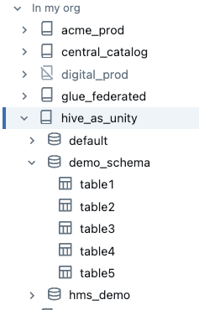
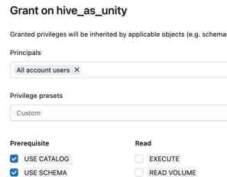
2
1
Manage it alongside other catalogs.
Mount your Hive Metastore as a catalog.
3
Use a unified governance model.
source/_static/images/unity-catalog/hive-as-unity.png

Slide 124
source/_static/images/unity-catalog/hive-federation-diagram.png
Unity Catalog
Crawl
Federated catalog
Hive Metastore
Unity Catalog
Governance Layer
New workloads
Query execution
Other catalogs
Existing workloads
Notes:
8.30 mins up to here

Slide 125
source/_static/images/unity-catalog/federated-catalog-new-workload.png
Unity Catalog
Crawl
hms_in_uc
Hive Metastore
Unity Catalog
Governance Layer
New workloads
Query execution
Other catalogs
Existing workloads
Notes:
8.30 mins up to here

Slide 126
source/_static/images/unity-catalog/federated-catalog.png
Unity Catalog
Crawl
hms_in_uc
Hive Metastore
Unity Catalog
Governance Layer
Query execution
Other catalogs
Existing workloads
Notes:
8.30 mins up to here

Slide 127
source/_static/images/unity-catalog/hms-federation-migration-overview.png
Unity Catalog
Crawl
hms_in_uc
New workloads
Hive Metastore
Unity Catalog
Governance Layer
Query execution
Other catalogs
Migrated workloads
Existing workloads
Incremental migration
Notes:
8.30 mins up to here

Slide 128
source/_static/images/unity-catalog/federated-catalog-wins.png
Unity Catalog
UC permissions applied
Federated catalog
Hive Metastore
All workloads
Other catalogs
Lineage collected
Source of truth
Notes:
8.30 mins up to here

Slide 129


source/_static/images/clean-rooms/clean-room-data-access.png
Your workspace
Delta Sharing
Central clean room
Request table
Unity Catalog
Delta Sharing
Ephemeral pre-signed URLS
Clean room job
Generate
URLS
Tables and volumes
Direct download
from object store
Object store
Notes:
8.30 mins up to here

Slide 130
MLflow integration overview /_static/images/mlflow/mlflow-databricks-integration-ml.png
Databricks-managed MLflow manages the ML model lifecycle
MLflow Model Registry, integrated with Unity Catalog, centralizes all AI models and artifacts.
Use Mosaic AI to train models or fine-tune foundation models.
2. Model training
3. Tracking
4. Model Registry
1. Feature Store
MLflow tracks training by logging parameters, metrics, and artifacts to evaluate and compare model performance.
Databricks automated feature lookups simplifies integration and reduces mistakes.
6. Monitoring
5. Model Serving
MLflow automatically captures requests and responses to monitor and debug models.
Model Serving deploys models to a REST API endpoint.
Unity Catalog
Govern all data and AI assets
Cloud Data Lake
All structured and unstructured data

Slide 131
MLflow integration overview /_static/images/mlflow/mlflow-databricks-integration-agents.png
Databricks-managed MLflow manages the genAI app lifecycle
Mosaic AI Agent Framework and Agent Evaluation help you create agents and evaluate their output.
MLflow Model Registry, integrated with Unity Catalog, centralizes all AI models and artifacts.
2. Create and evaluate AI agents
3. Tracking and tracing
4. Model Registry
1. Vector & Feature Store
MLflow tracing captures detailed agent execution information for enhanced genAI observability.
Databricks automated vector and feature lookups simplifies integration and reduces mistakes.
6. Monitoring
5. Model Serving
MLflow automatically captures requests and responses to monitor and debug models.
Model Serving deploys agents to a REST API endpoint.
Unity Catalog
Govern all data and AI assets
Cloud Data Lake
All structured and unstructured data

Slide 132
RAG development & LLMops lifecycle
/_static/images/generative-ai/development-lifecycle.png
AI agent development lifecycle
Iterate to improve
Agent metrics
Prepare data
Create agent tools
Build prototype
Label evaluation data
Agent trace
Collect feedback
Deploy to production
Monitor in production
Model versioning
ETL pipeline
Unity Catalog functions
AI Playground
Agent Evaluation
Review App
Model Serving
Evaluation job
Agent Framework
LLM judges
Synthetic data
MLflow tracking

Slide 133
RAG development & LLMops lifecycle
/_static/images/generative-ai/development-lifecycle.png
AI agent development lifecycle
Iterate to improve
Agent metrics
Prepare data
Create agent tools
Build prototype
Label evaluation data
Agent trace
Collect feedback
Deploy to production
Monitor in production
Model versioning
ETL pipeline
Unity Catalog functions
AI Playground
Agent Evaluation
Review App
Model Serving
Evaluation job
Agent Framework
LLM judges
Synthetic data
MLflow tracking

Slide 134
Unstructured data pipeline /static/images/ai-cookbook/intro-and-rag/unstructured-data-pipeline.png
RAG application
Evaluation and monitoring
User request
Response
RAG chain
Embedding and foundation models
Unstructured data pipeline
Enterprise data
Corpus ingestion
Data processing
Chunking
Embedding
Indexing and storage
Vector Search Index
Governance and LLMops

Slide 135
Unstructured data pipeline /static/images/ai-cookbook/intro-and-rag/rag-overview..png
RAG application
Evaluation and monitoring
User request
Response
RAG chain
Enterprise data
Data pipeline
Governance and LLMops

Slide 136
Multi-agent framework static/images/generative-ai/multi-agent-framework.png
RAG application
_start_
supervisor
FINISH
GenieAgent
Agent1
Agent2
_end_

Slide 137
Example agent system /_static/images/generative-ai/guide/example-ai-agent-system.png
“Help me return my last order.”
Reason about what to do
1
Find information
2
Customer
Reason about what to do
3
Agent
Take action
4
“Done! Here is your shipping label…”
Reason about what to do
5

Slide 138

Example agent system /_static/images/generative-ai/guide/ai-app-inputs.png
“Help me return my last order.”
Vector index with company policies.
Customer
validate_order_can_be_returned(...)
start_return_for_order(...)
API
</>
Agent
“Done! Here is your shipping label…”
Delta table with order history.

Slide 139
/_static/images/generative-ai/guide/basic-rag-pipeline.png
Parse
query
Retrieve related docs
Augment prompt
Generate response
User
LLM

Slide 140
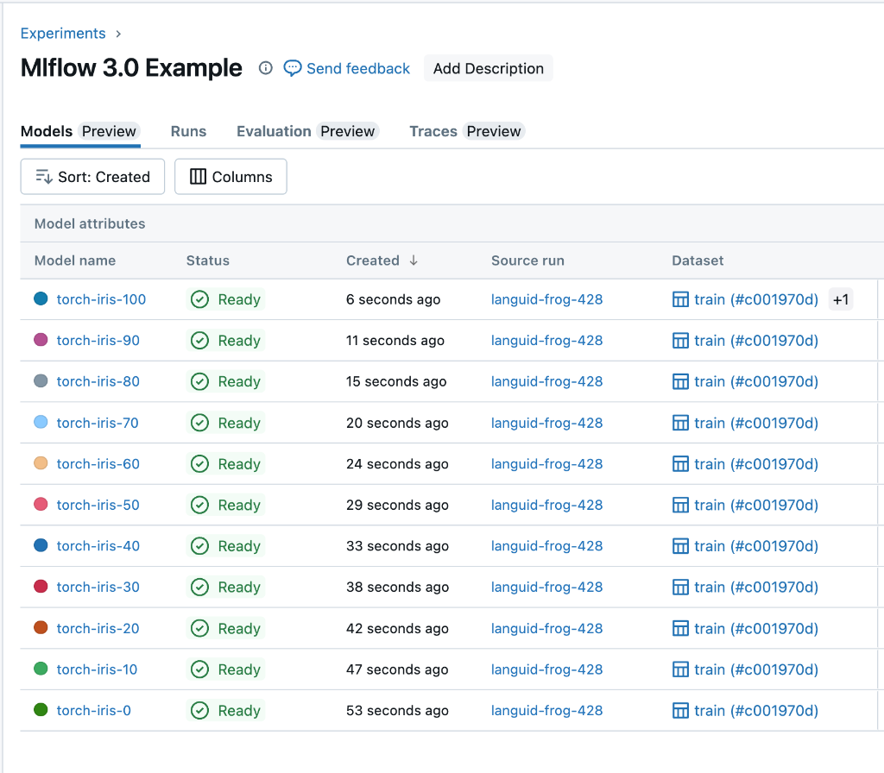
/_static/images/mlflow/mlflow-logged-model-tracking.png
LoggedModels
tie together all of a model’s critical information such parameters, metrics, and artifacts using a unique model ID.
MLflow experiment
Logged model
model_id = 2
name = bar-1
model = AI-agent
parameters = {...}
metrics = {...}
eval feedback = {...}
trace logs = {...}
MLflow run
Logged during authoring
Gen AI agents
Search and filter LoggedModels through a unified interface.
Evaluation feedback
Trace logs
MLflow experiment
Logged model
model_id = 1
name = foo-1
step = 1
model = DL-model
parameters = {...}
metrics = {...}
Deep learning
MLflow run
Logged for each checkpoint
MLflow experiment
Logged model
model_id = 1
name = foo-1
model = ML-model
parameters = {...}
metrics = {...}
Traditional ML
MLflow run
Logged during training

Slide 141
/_static/images/data-engineering/data-engineering-overview.png
Orchestration
Lakeflow Jobs
Schedules and triggers
Interfaces and abstractions
Lakeflow Connect
UI and configuration, Managed connectors
Lakeflow Declarative Pipelines APIs for flows, sinks, streaming tables, materialized views
Apache Spark and Structured Streaming: DataFrame APIs
Runtime
Databricks Runtime for Apache Spark
Standard connectors
Apache Spark and Structured Streaming Engine

Slide 142
Data source
Processing
Target
Pipeline
Streaming Semantics
Streaming Target
Streaming Sources
Files, Tables, Events, Change Data Feeds, etc.
Flow types:
Append, Update, and Complete
Sink
Flow type:
Apply Changes
Streaming table
Batch Semantics
Batch Target
Batch Sources
Files, Tables
Flow type: Materialized view
Materialized view

Slide 143
Pipeline
Sources
Streaming source
Additional targets
Targets
Streaming source
Streaming table
Materialized view
Batch or streaming source
Materialized view
Materialized view
Flows
Additional Flows

Slide 144
/_static/images/tables/st-ingestion.png
Streaming source Files, events in a message bus, or other streaming data
Flow Handles each input exactly once, over multiple refreshes
Streaming table

Slide 145
/_static/images/tables/mv-ingestion.png
Source data Tables, files, or other data
Flow Handles the required input to keep the output correct, often incrementally.
Materialized view

Slide 146
/_static/images/tables/mv-update.png
clean_customers (200 rows inserted, for customers in NL, UK, and USA)
Flow (incrementally updates 3 rows for the countries affected by the changes)
sales_report
(materialized view)
clean_transactions (5000 rows upserted for those customers’ transactions)

Slide 147
Pipeline
Streaming Processing
Streaming Target
Streaming Source
Files, tables, streaming tables, messages/events, change data feeds, etc.
Append flow
Sink
Auto CDC flow
Streaming table
Batch Processing
Batch Target
Batch Source
Files, tables, streaming tables, materialized views, etc.
Materialized view flow
Materialized view

Slide 148
Pipeline (Streaming)
Pipeline (Batch)
Streaming Targets
Batch Targets
Sink
Streaming table
Streaming table
Materialized view
Flows
Flows
Batch
Append flow
Apply Changes flow
Materialized view flow
ONCE flow
APPLY CHANGES FROM SNAPSHOT
Materialized view flow
Streaming Source
Files, tables, streaming tables, messages/events, change data feeds, etc.
Batch Source
Files, tables, streaming tables, materialized views, etc.

Slide 149
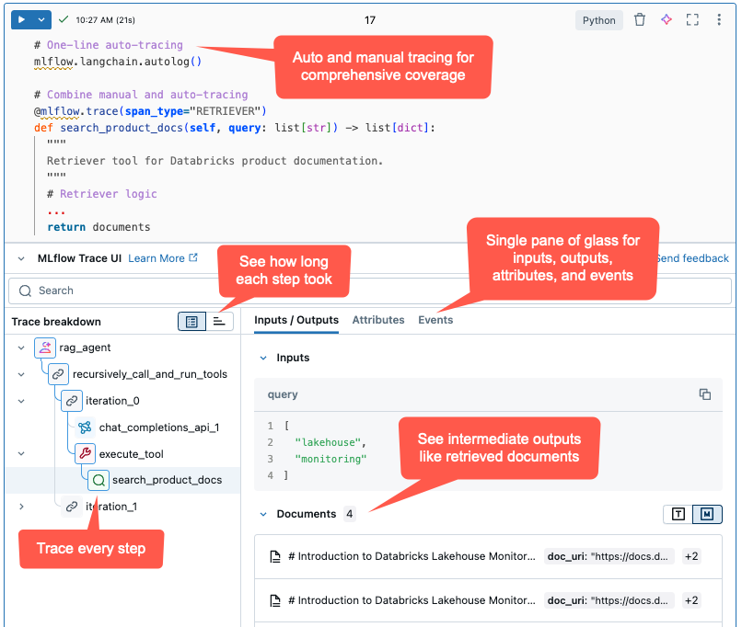
/_static/images/mlflow/agent-trace-ui.png

Slide 150
Unstructured data pipeline /static/images/ai-cookbook/intro-and-rag/unstructured-data-pipeline.png
Simplified RAG
Retrieve supporting data
Augment prompt with supporting data
Generate
a response
User prompt
Response
LLM
+
Prompt
+
Supporting data
Prompt
+
Supporting data
Prompt
Data sources

Slide 151
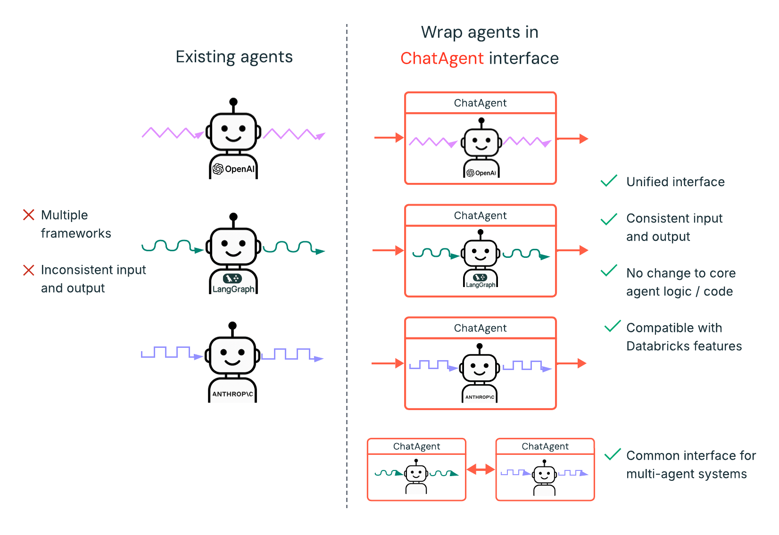

Slide 152
DLT pipeline tutorial/static/images/dlt/dlt-tutorial/dlt_tutorial_cdc_pipeline.png
Job
Orchestrate ETL pipeline
ETL pipeline
customers
Auto Loader Incrementally load new data
Clean CDC data
Make sure data
is correct
Raw CDC files (json)
customers_cdc_bronze
customers_cdc_clean
Materialized view
customers_history
customers_history_agg
AUTO CDC
Automatically merge and materialize the customer table

Slide 153

DLT pipeline tutorial/static/images/dlt/streaming_processing.png
Data Source
Streaming Processing
3rd Hour
2nd Hour
1st Hour

Slide 154
DLT pipeline tutorial/static/images/dlt/batch_processing.png
Data Source
Batch Processing
1st Hour
2nd Hour
3rd Hour

Slide 155
/dlt/convert-dlt-pipeline-dabs-process.png
Existing ETL pipeline
Create bundle project
Generate bundle config
Review settings
Bind pipeline
Deploy bundle

Slide 156
/images/security/privacy/gdpr-get-started-materialized-views.png
Deletions
UPDATE/DELETE
AUTO CDC
GROUP BY
INSERT
Source
Materialized view

Slide 157
/images/security/privacy/gdpr-get-started-streaming.png
Deletions
Streaming is NOT supported
UPDATE/DELETE
AUTO CDC
GROUP BY
Source
X
Streaming table
Streaming IS supported
INSERT
Source
Streaming table

Slide 158
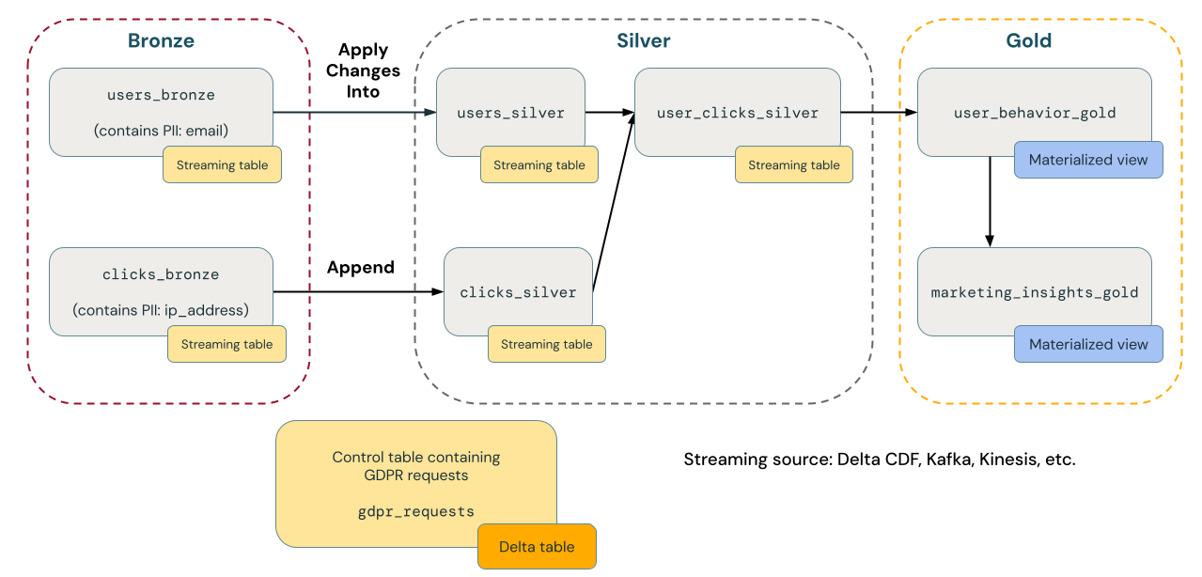
/images/security/privacy/gdpr-get-started-example.png NOTE: Edited, not all vector… :(
Auto CDC
Append

Slide 159






High-level architecture
/_static/images/security/network/aws-s3.png
S3
Users and applications
Databricks Serverless Plane
Databricks Control Plane
Control plane
Your Security Group
Web application
S3
BI Apps
Dedicated S3 interface endpoint
Your
Compute
Compute orchestration
Unity Catalog
S3
Queries and code
Delta Sharing

Slide 160



High-level architecture
/_static/images/security/network/pl-aws.png
Users and applications
Databricks Serverless Plane
Databricks Control Plane
Your VPC
Control plane
Private Subnet
Your Security Group
Web application
BI Apps
Dedicated Interface Endpoint
Your
Compute
Compute orchestration
Network Load Balancer
Unity Catalog
Your Resources
Queries and code
Delta Sharing

Slide 161


High-level architecture
/_static/images/security/network/pl-aws.png
Users and applications
Databricks Serverless Plane
Databricks Control Plane
Your VPC
Private Link Subnet
Control plane
Private
Endpoint
NLB Subnet
Your Resources
Web application
BI Apps
Compute orchestration
Network Load Balancer
Serverless Compute
Subnet
Unity Catalog
Queries and code
Delta Sharing
Dedicated Compute
AWS PrivateLink

Slide 162



High-level architecture
/_static/images/security/network/pl-azure.png
Your VNet
Users and applications
Databricks Serverless Plane
Databricks Control Plane
Control plane
Private Subnet
Your Security Group
Web application
BI Apps
Load Balancer
Dedicated Private
Endpoint
Your
Compute
Compute orchestration
Unity Catalog
Your Resources
Queries and code
Delta Sharing

Slide 163


High-level architecture
/_static/images/security/network/pl-azure-be.png
Workspace VNet
Databricks Control Plane
Control plane
Private “Worker” subnet
databricks_ui_api
private endpoint
Web application
Compute orchestration
Compute clusters
Unity Catalog
Public “Host” subnet
Queries and code
Private endpoint subnet

Slide 164


High-level architecture
/_static/images/security/network/pl-azure-fe.png
Customer On-premises & Cloud
Transit VNet
Databricks
Users and applications
Control plane
Entra ID service
Web application
browser_authentication private endpoint
BI Apps
Compute orchestration
ExpressRoute/VPN
Azure Private Link service
Unity Catalog
databricks_ui_api
private endpoint
Queries and code
Delta Sharing

Slide 165
High-level architecture
/_static/images/security/network/pl-azure-fe.png
Workspace VNet
Private “Worker” subnet
databricks_ui_api
private endpoint
Compute clusters
Public “Host” subnet
Databricks
Private endpoint subnet
Control plane
Web application
Customer On-Premises & Cloud
Entra ID service
Compute orchestration
Transit VNet
Unity Catalog
Users and applications
Azure Private Link service
Queries and code
browser_authentication private endpoint
BI Apps
ExpressRoute/VPN
databricks_ui_api
private endpoint
Delta Sharing

Slide 166




High-level architecture
/_static/images/security/network/service-endpoints.png
Azure Databricks managed storage
Azure Databricks Workspace
1
2
4
Customer managed storage
3
Azure virtual network service endpoint
Public subnet
x
Private subnet
5
Unsanctioned storage

Slide 167
Production tracing /images/mlflow3/prod-tracing-overview.png
Databricks workspace
Users
Response
Model Serving
application
Inference
Delta table
Request
AI Gateway
Traces
MLflow
tracking server
Monitoring
Delta table
Production monitoring

Slide 168
Production tracing /images/mlflow3/prod-tracing-overview-external.png
Users
Databricks workspace
Request
Response
External
application
MLflow
tracking server
Monitoring
Delta table
Traces
Production monitoring

Slide 169
High-level architecture
/_static/images/security/network/pl-azure.png
Your VNet
Users and applications
Databricks Serverless Plane
Databricks Control Plane
Private Subnet
Control plane
Your Security Group
Web application
BI Apps
Standard Load Balancer
Dedicated Private
Endpoint
Compute orchestration
Your
Compute
Unity Catalog
Your Resources
Queries and code
Delta Sharing

Slide 170



High-level architecture
/_static/images/security/network/pl-azure.png
Customer on premises
DNS
Transit VPC
Hub VPC
Control Plane
Browser
Workspace 1
Workspace 2
DNS Inbound
BI Tools
User
Workspace 3
Workspace N
REST Client
AWS Direct Connect / VPN
AWS Direct Connect / VPN Gateway
Front-end VPCE

Slide 171
High-level architecture
/_static/images/security/network/pl-azure.png
Customer on premises
DNS
Transit VPC
Prod VPC
Control plane
Browser
Prod workspace
DNS Inbound
BI Tools
User
Prod workspace
Non-prod workspace
REST Client
AWS Direct Connect / VPN
AWS Direct Connect / VPN Gateway
Front-end VPCE
Non-prod VPC
Front-end VPCE2

Slide 172
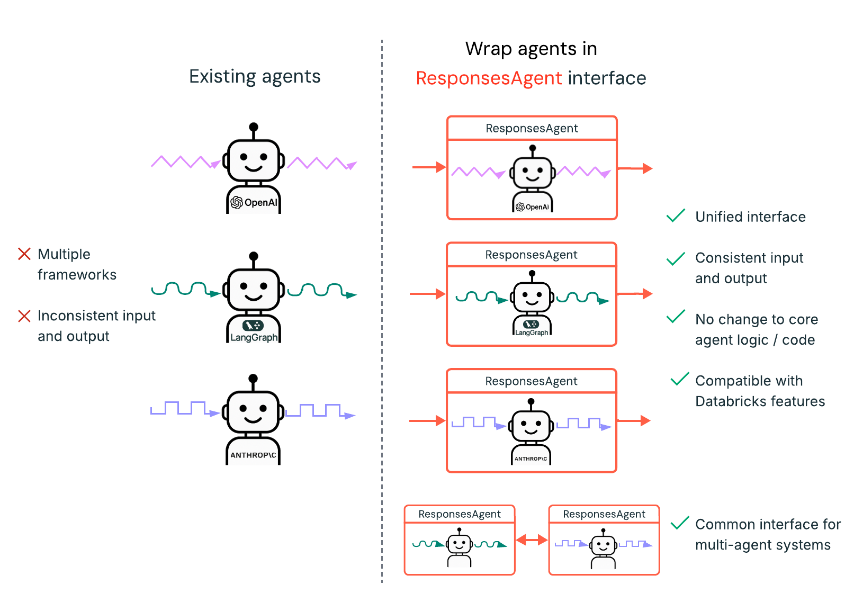
ResponsesAgent interface
/_static/images/generative-ai/responses-agent-overview.svg

Slide 173
DLT-META overview /images/dlt/dlt-meta-overview.svg
Input
1
Onboarding files
dlt-meta API
Onboard processing
2
Stored metadata
Pipelines: DataflowPipeline
Source data
3
Bronze
Silver
4
Raw ingestion, and history
Filtered, cleaned, augmented

Slide 174
Input
Onboarding files
dlt-meta API
Onboard processing
Stored metadata
Pipelines: DataflowPipeline
Source data
Bronze
Silver
Raw ingestion, and history
Filtered, cleaned, augmented

Slide 175
DLT pipeline tutorial/static/images/dlt/dlt-recover-streaming-flow.png
Cloud storage
Customers
Change Data Feed
Customers
Initial snapshot
initial_snapshot_flow
Lakeflow Declarative Pipelines
customers_raw
(view) deduplicated
customers
(streaming table)
incremental_cdc_flow

Slide 176



Databricks Connect main image /static/images/db-connect/run-debug-code.png
Local IDE
Databricks workspace
from databricks.connect import DatabricksSession
spark = DatabricksSession.builder.getOrCreate()
df = spark.read.table("samples.nyctaxi.trips")
df = df.filter(df.trip_distance>0.5)
df_pd = df.limit(3).toPandas()
print(df_pd)
Data transformations run on Databricks compute
Databricks Connect
Compute
DataFrame API
Python code runs locally

Slide 177


DE concepts - Schema evolution main image /static/images/data-engineering/schema-evolution.png
Connectors
Auto Loader
Kafka
Kinesis
Lakeflow managed
Format parsers
JSON
Avro
XML
protobuf
Processing engine
Structured streaming
Schema evolution requires restart
Kafka + schema registry
Avro / Protobuf schemas
Datasets
Streaming tables
mergeSchema = true
Materialized views
Full refresh required
Delta tables
mergeSchema = true
Column mapping
Type widening
Views
WITH [TYPE] SCHEMA EVOLUTION

